Slide 1
Sitter Services App
Flow, Features and more

Slide 2
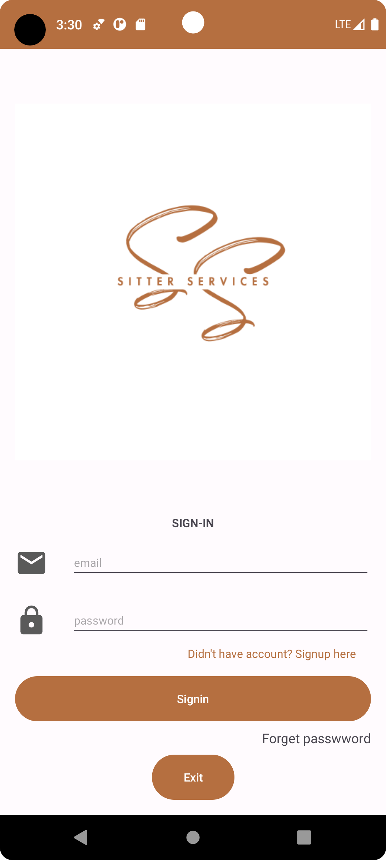
Main Screen
It integrates Firebase Authentication to secure user management and verification. Users can sign in, register, or reset passwords. The class also manages email verification and provides utility functions for messaging and progress tracking.

Slide 3
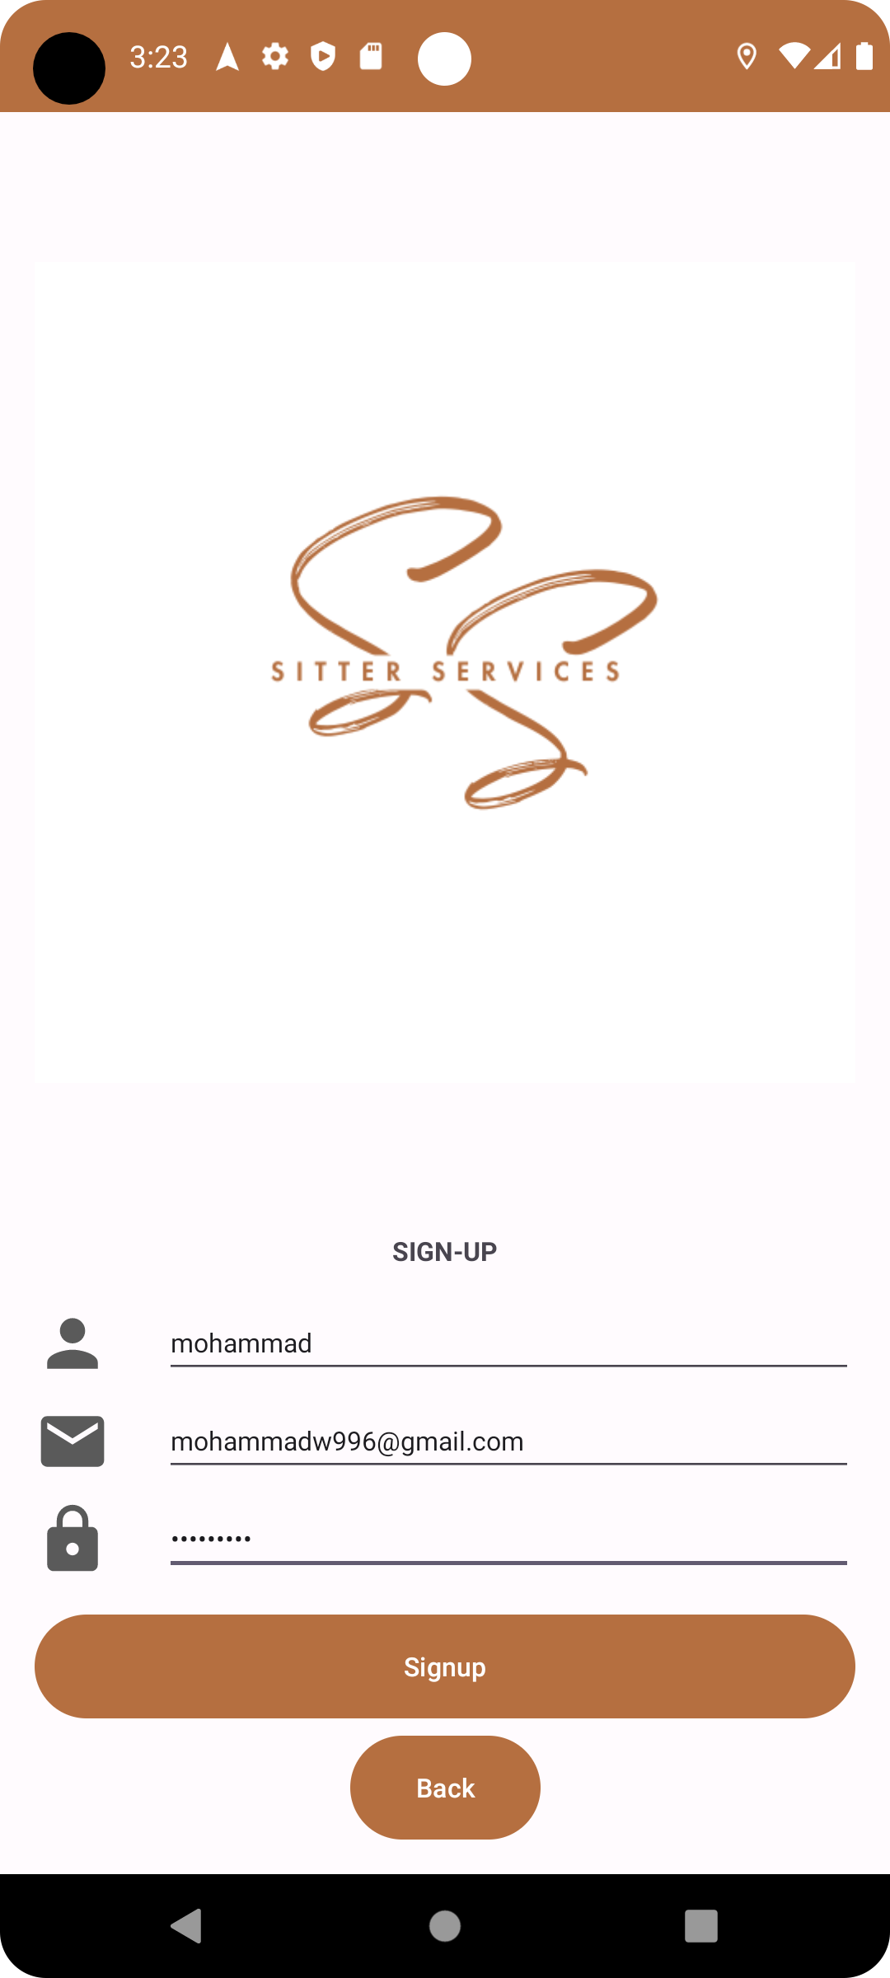
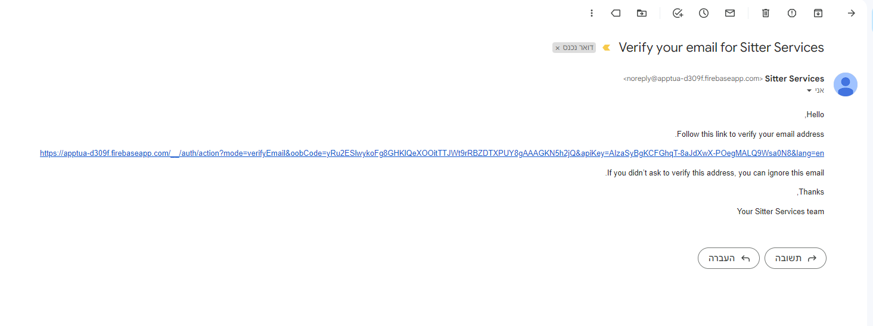
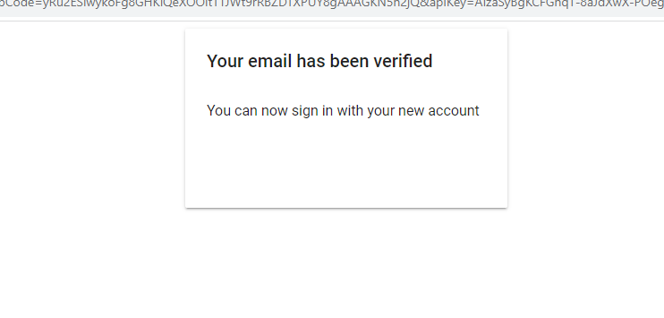
Signup Flow
Upon clicking the "Sign Up" button, the class checks for input validity, including email and password format. If the inputs are valid, it uses Firebase's authentication to create a new user account and sends a verification email. User details, such as username, email, and password, are stored in the Firebase Cloud Firestore database.
Verification email is sent and upon clicking on the link attached a new web page opens with the verification message.
Password format is one upper letter, one small letter, a special character, and 8 characters long.

Slide 4
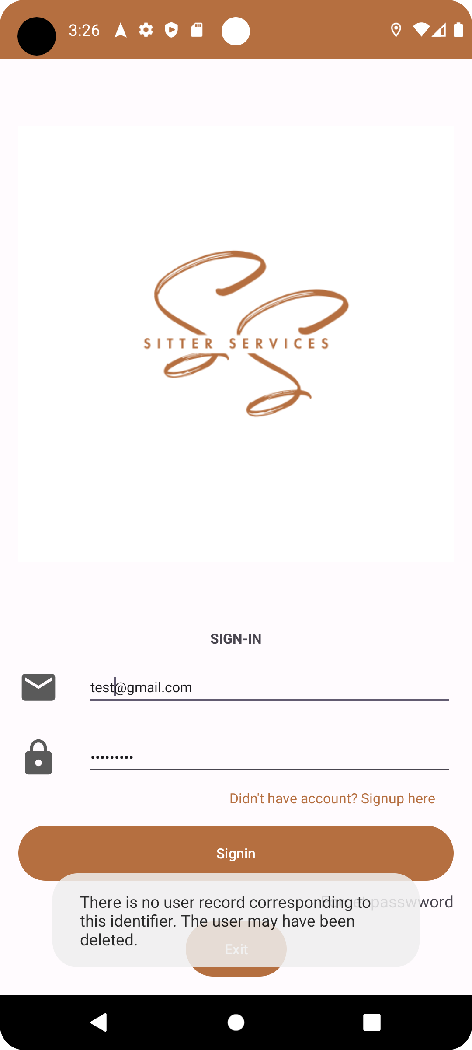
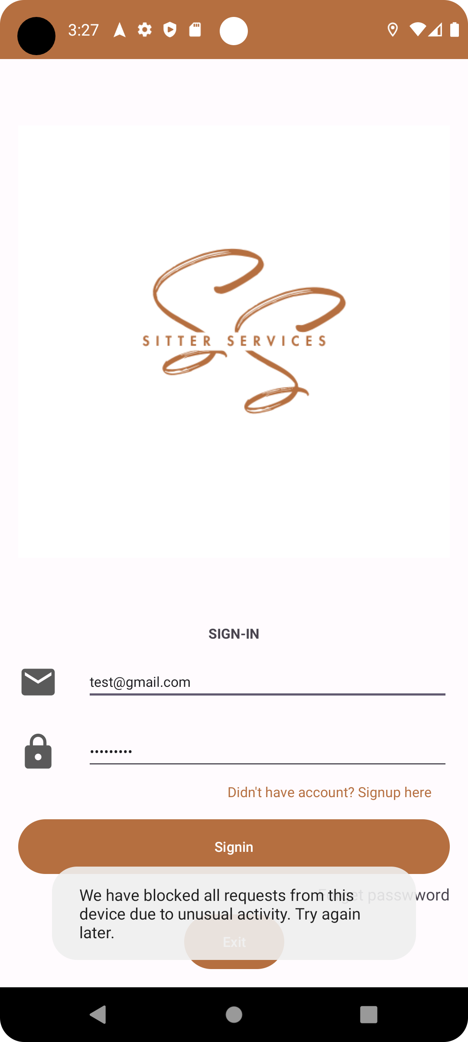
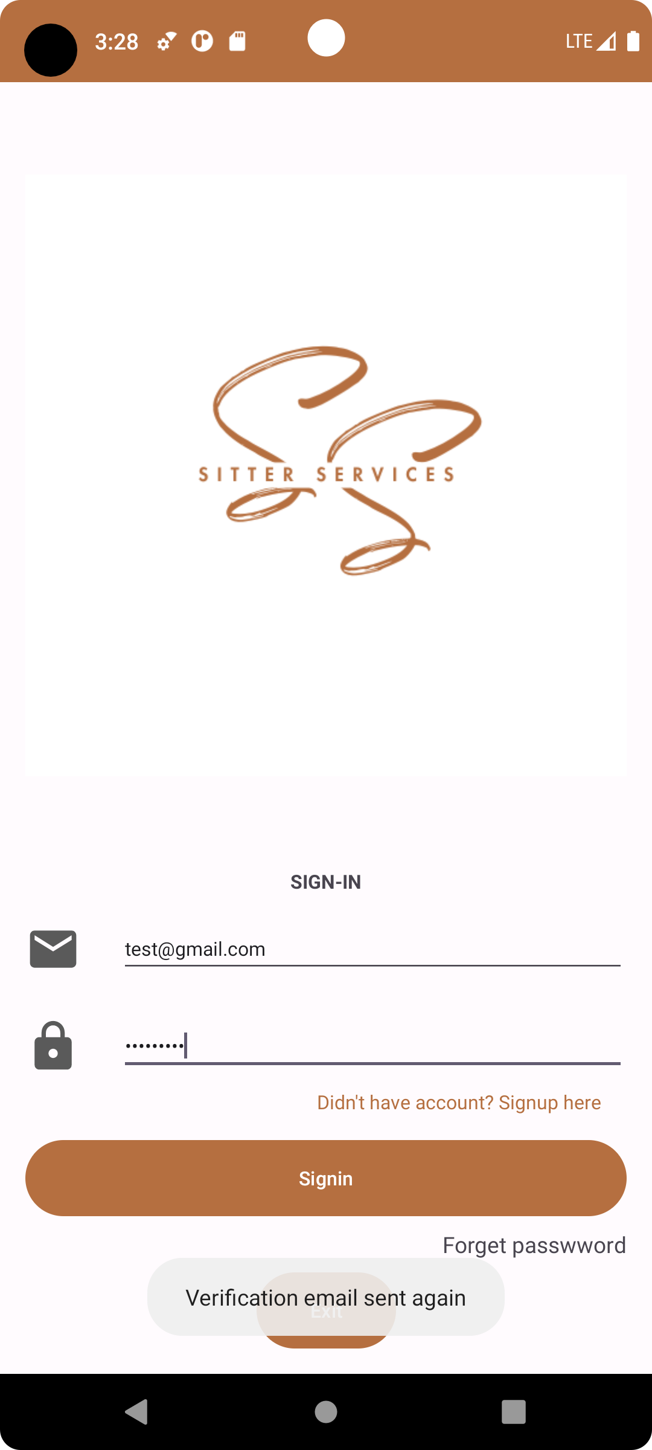
Sign in feature
Demonstration of users' validations in sign in page. - Left screen shot when users who did not register to the app try to log in.
Middle screenshot, when users try multiple failed sign ins, they get locked for some time.
Right screenshot, when users that did not verify their email try to log in.

Slide 5
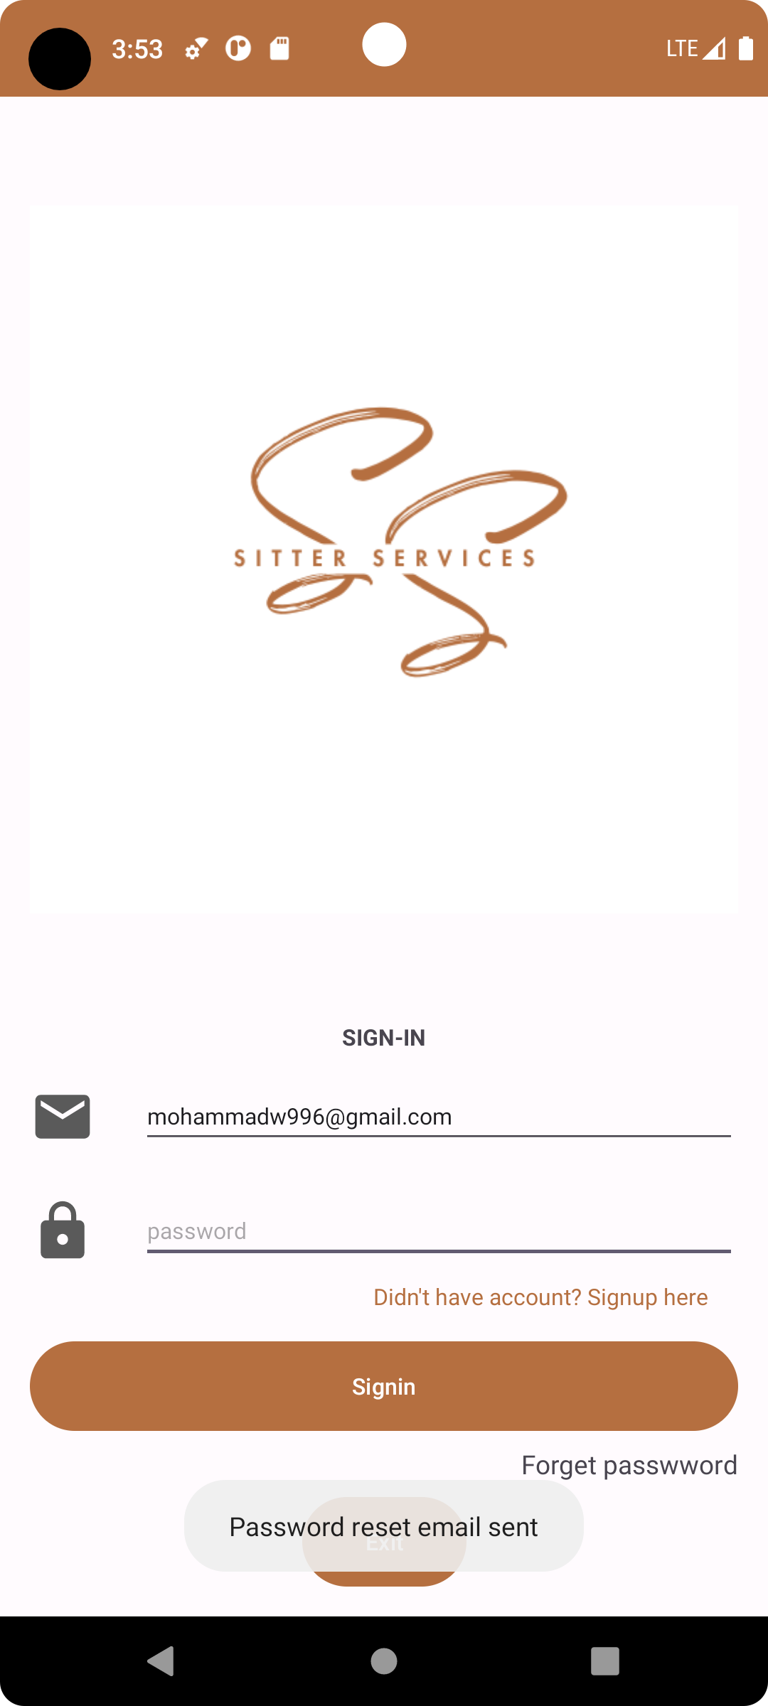
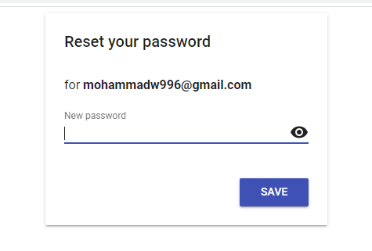
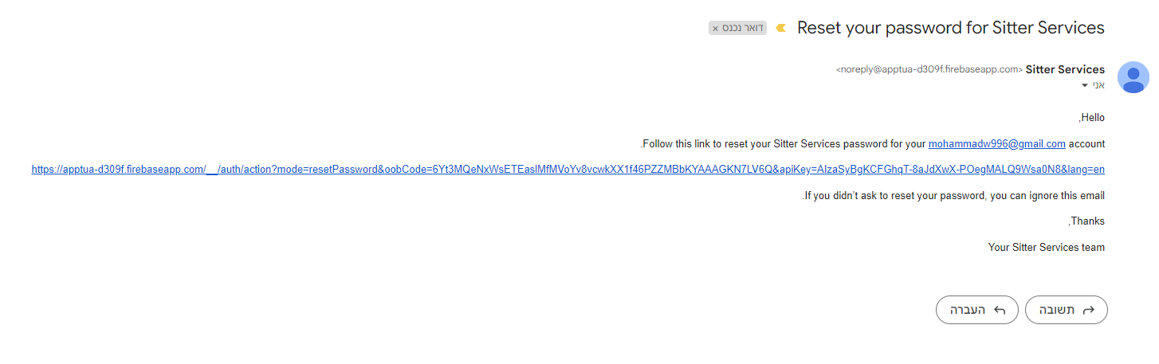
Forgot password feature
When a user press “Forget password” after entering his email, an email for resetting that password will be sent. After clicking on the link attached a new page is opened with an option to reset the password for the current user.

Slide 6
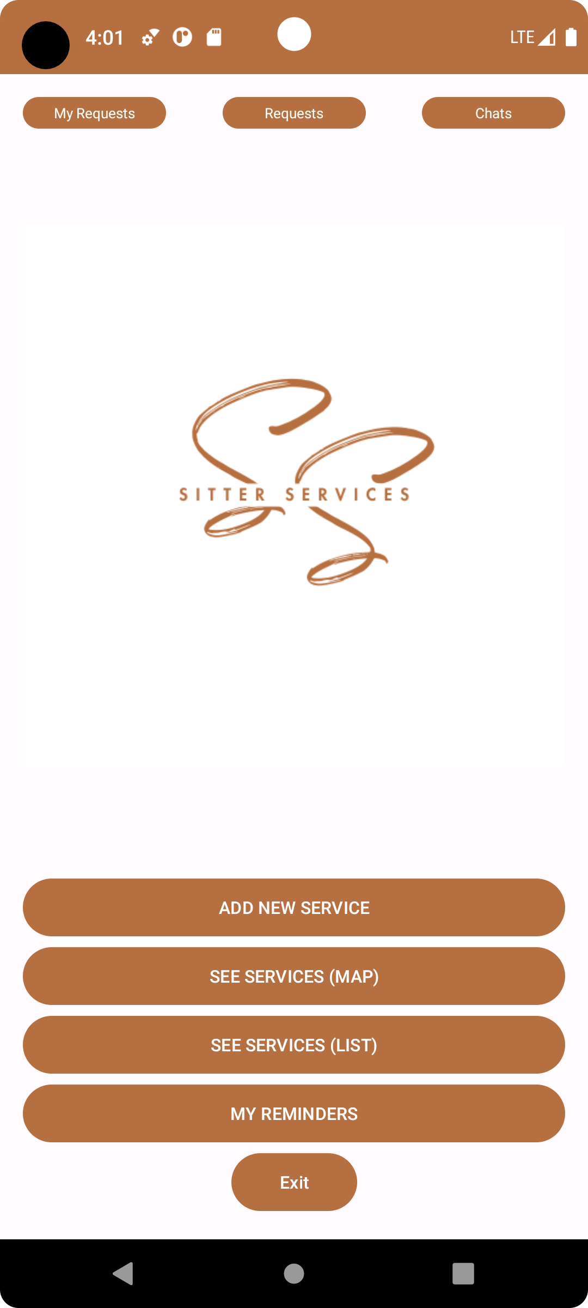
Home Screen
Home screen dynamically updates the UI based on user preferences stored in Firebase Firestore. The class enables navigation to different sections of the app, such as chats, reminders, requests, and maps. It also manages permissions, especially for location access, and provides an option to exit the app. Overall, the class ensures a seamless user experience by connecting various app features and functionalities.

Slide 7
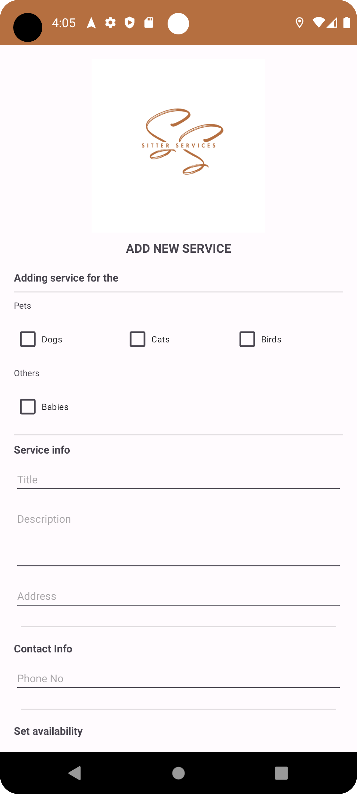
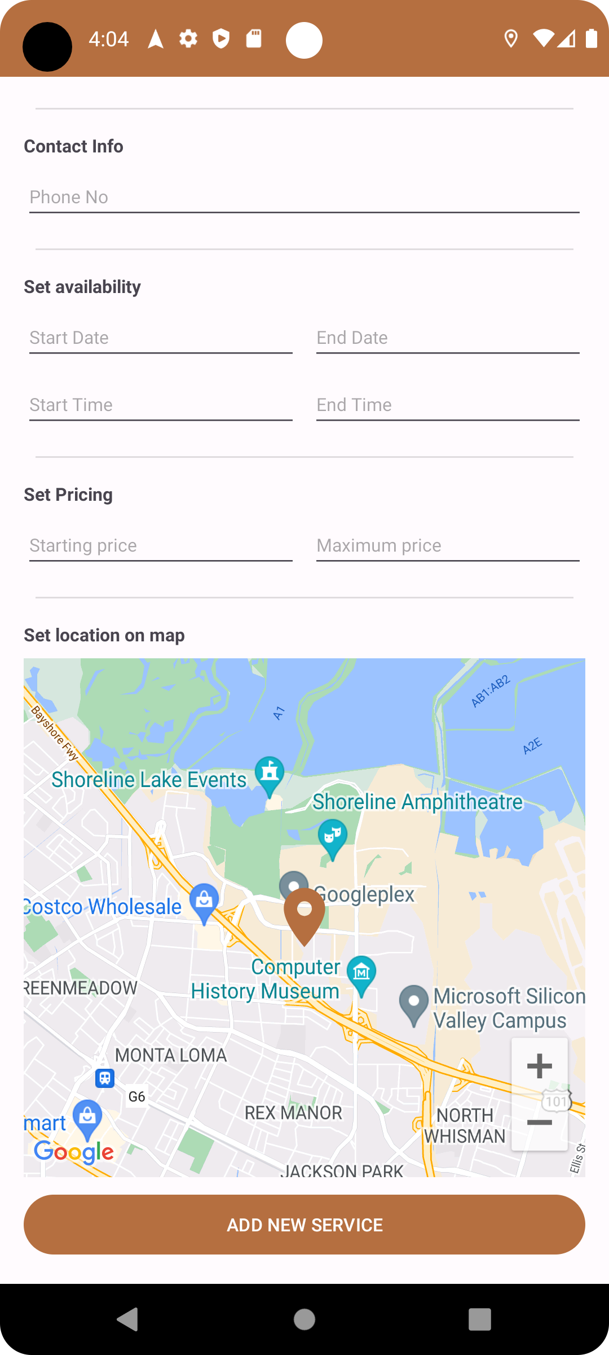
Add new service feature
This feature enhances user engagement by offering a comprehensive view of services, intuitive date and time handling, easy communication with providers, and seamless integration with Firebase Firestore for data management.
Displays comprehensive service details, including user information, service info, contact details, availability, pricing, and categories.
Integrates Google Maps to showcase the service provider's location with a marker.
Allows users to request services by opening a dialog for inputting request details, dates, notes, and reminders.
Supports setting reminders for specific request-related dates and times.
Enables users to initiate chats with service providers through a dedicated button.
Provides a user-friendly interface for adding reminders and specifying dates and times.
Dynamically updates the UI based on fetched service and user data.
Efficiently handles date and time selection using intuitive dialogs.
Uses Firebase Firestore for effective data management.

Slide 8
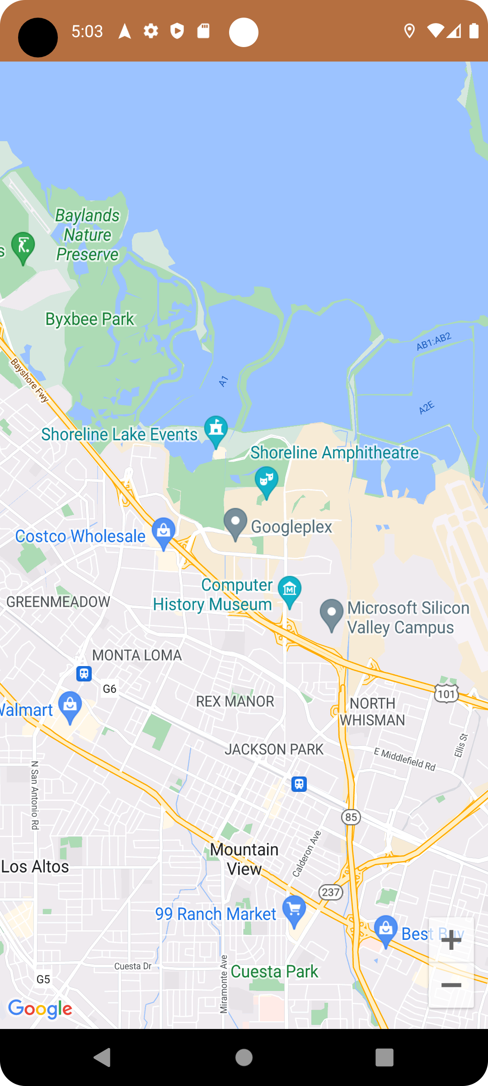
See Services (Map)
Displays a Google Map with markers representing different services.
Retrieves service data from Firebase Firestore to populate the map.
Retrieves the user's current location using the Fused Location Provider Client.
Handles cases of successful and unsuccessful location retrieval.
Implements marker click listeners to open detailed service information.
Dynamically adjusts the map view based on markers and user location.
Efficiently manages map interactions, such as zoom controls.

Slide 9
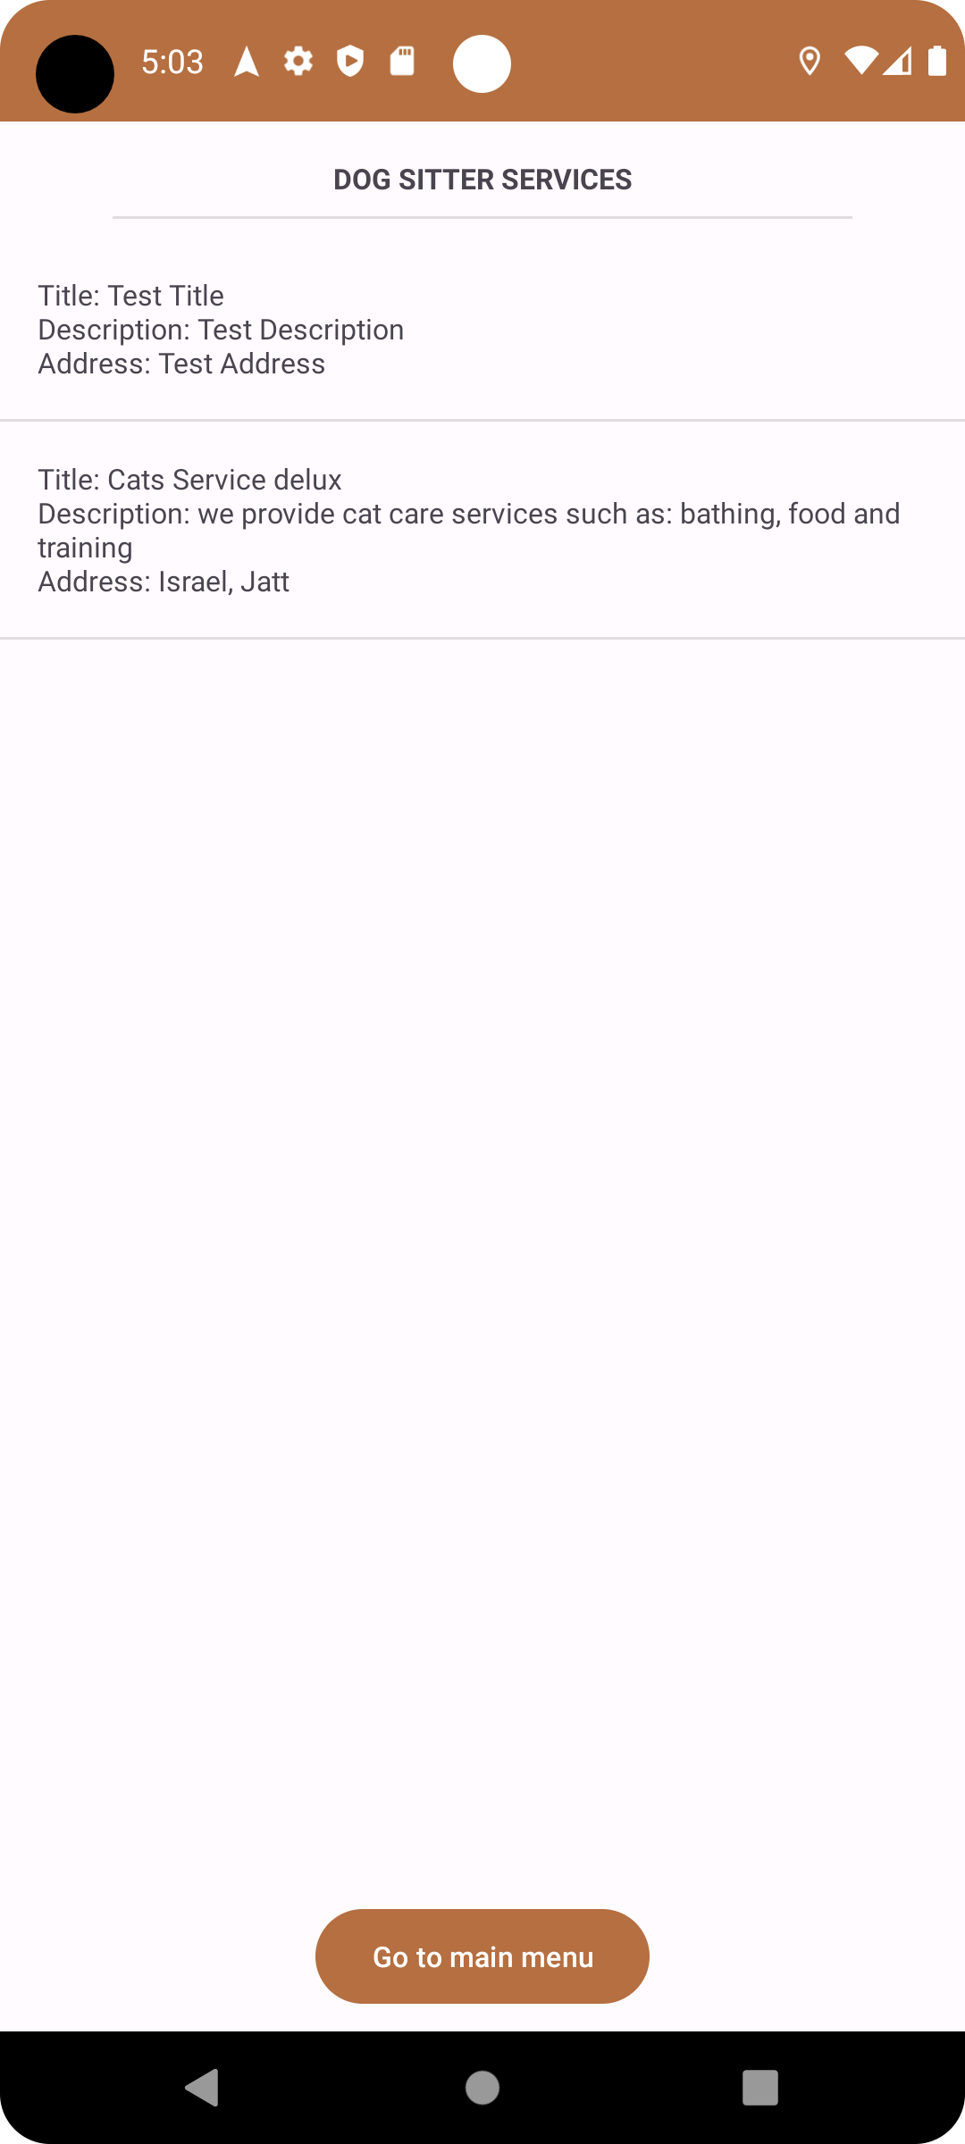
See Services (List)
connects to a Firestore database to retrieve a list of services. The app displays this list using a ListView with customized items. When the user clicks on a service, the app transitions to a "DetailActivity" to show more information about the selected service. A progress dialog is used to indicate loading while data is fetched from Firestore. Overall, the app efficiently manages data retrieval, list display, user interaction, and navigation to provide a seamless experience for exploring and learning about different services.

Slide 10
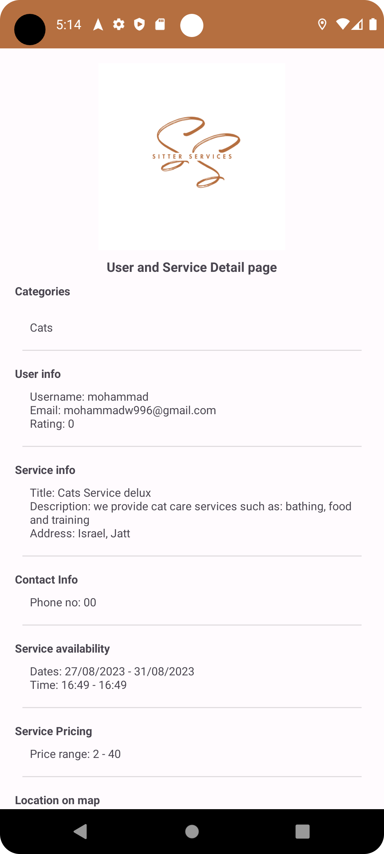
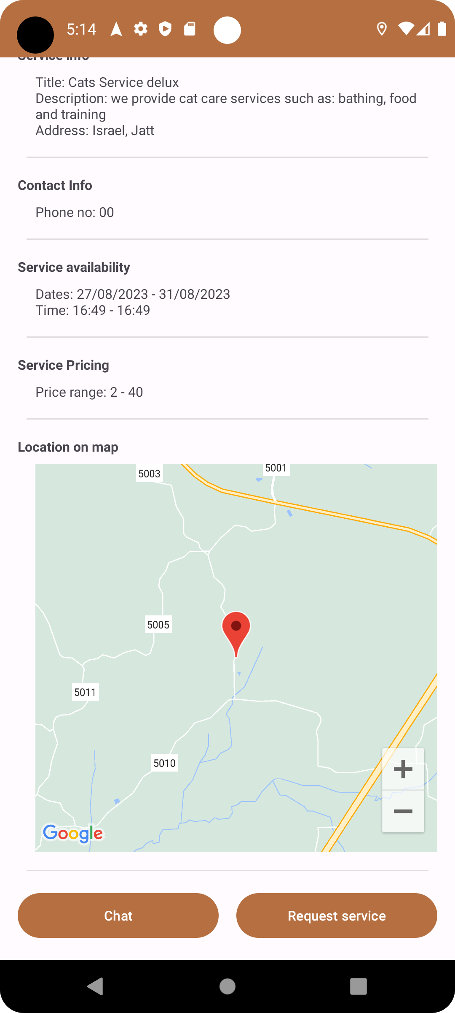
Requesting service flow (1)
After selecting a service from photo(1) another page will be open with the service details(photo 2). In the bottom of the screen there is an option to chat with the provider or request a service (photo 3).
1
2
3

Slide 11
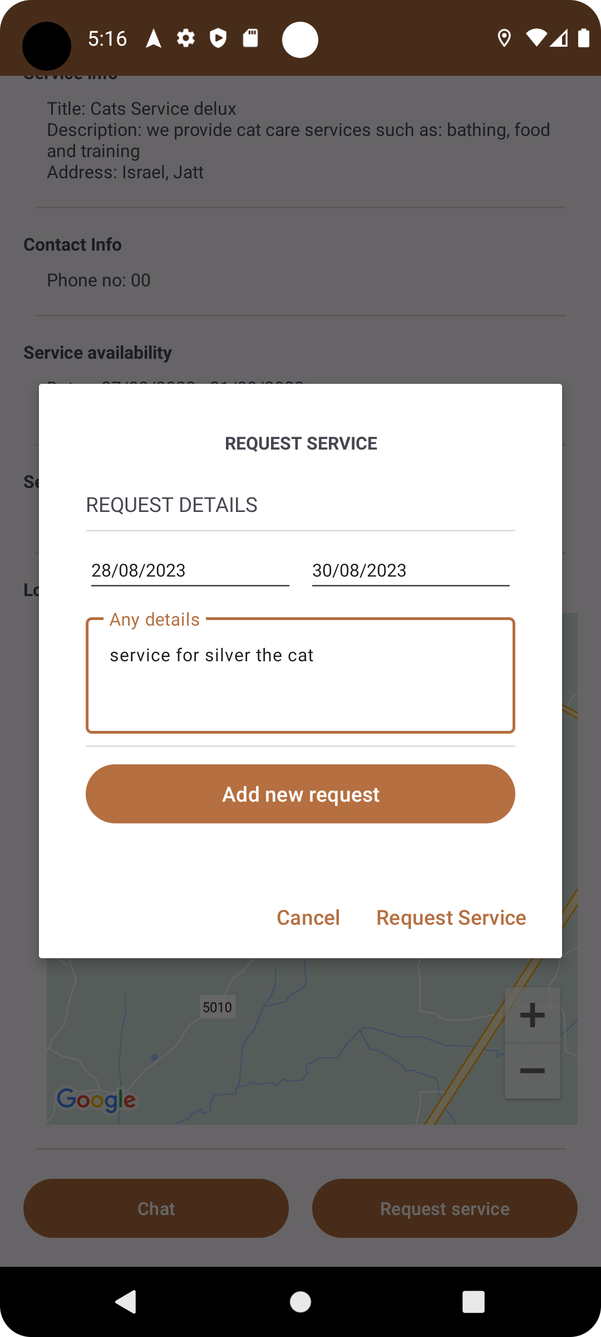
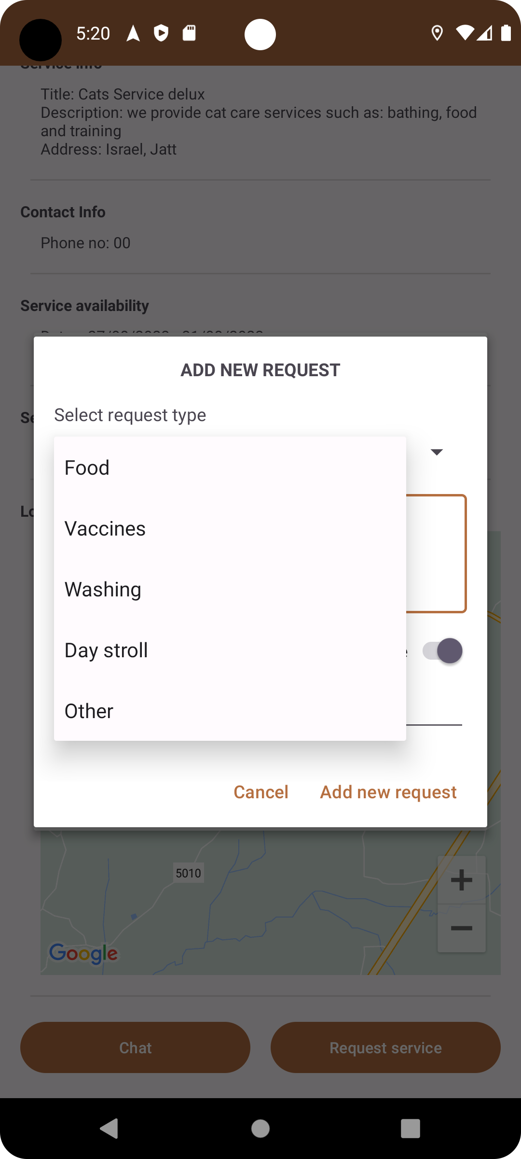
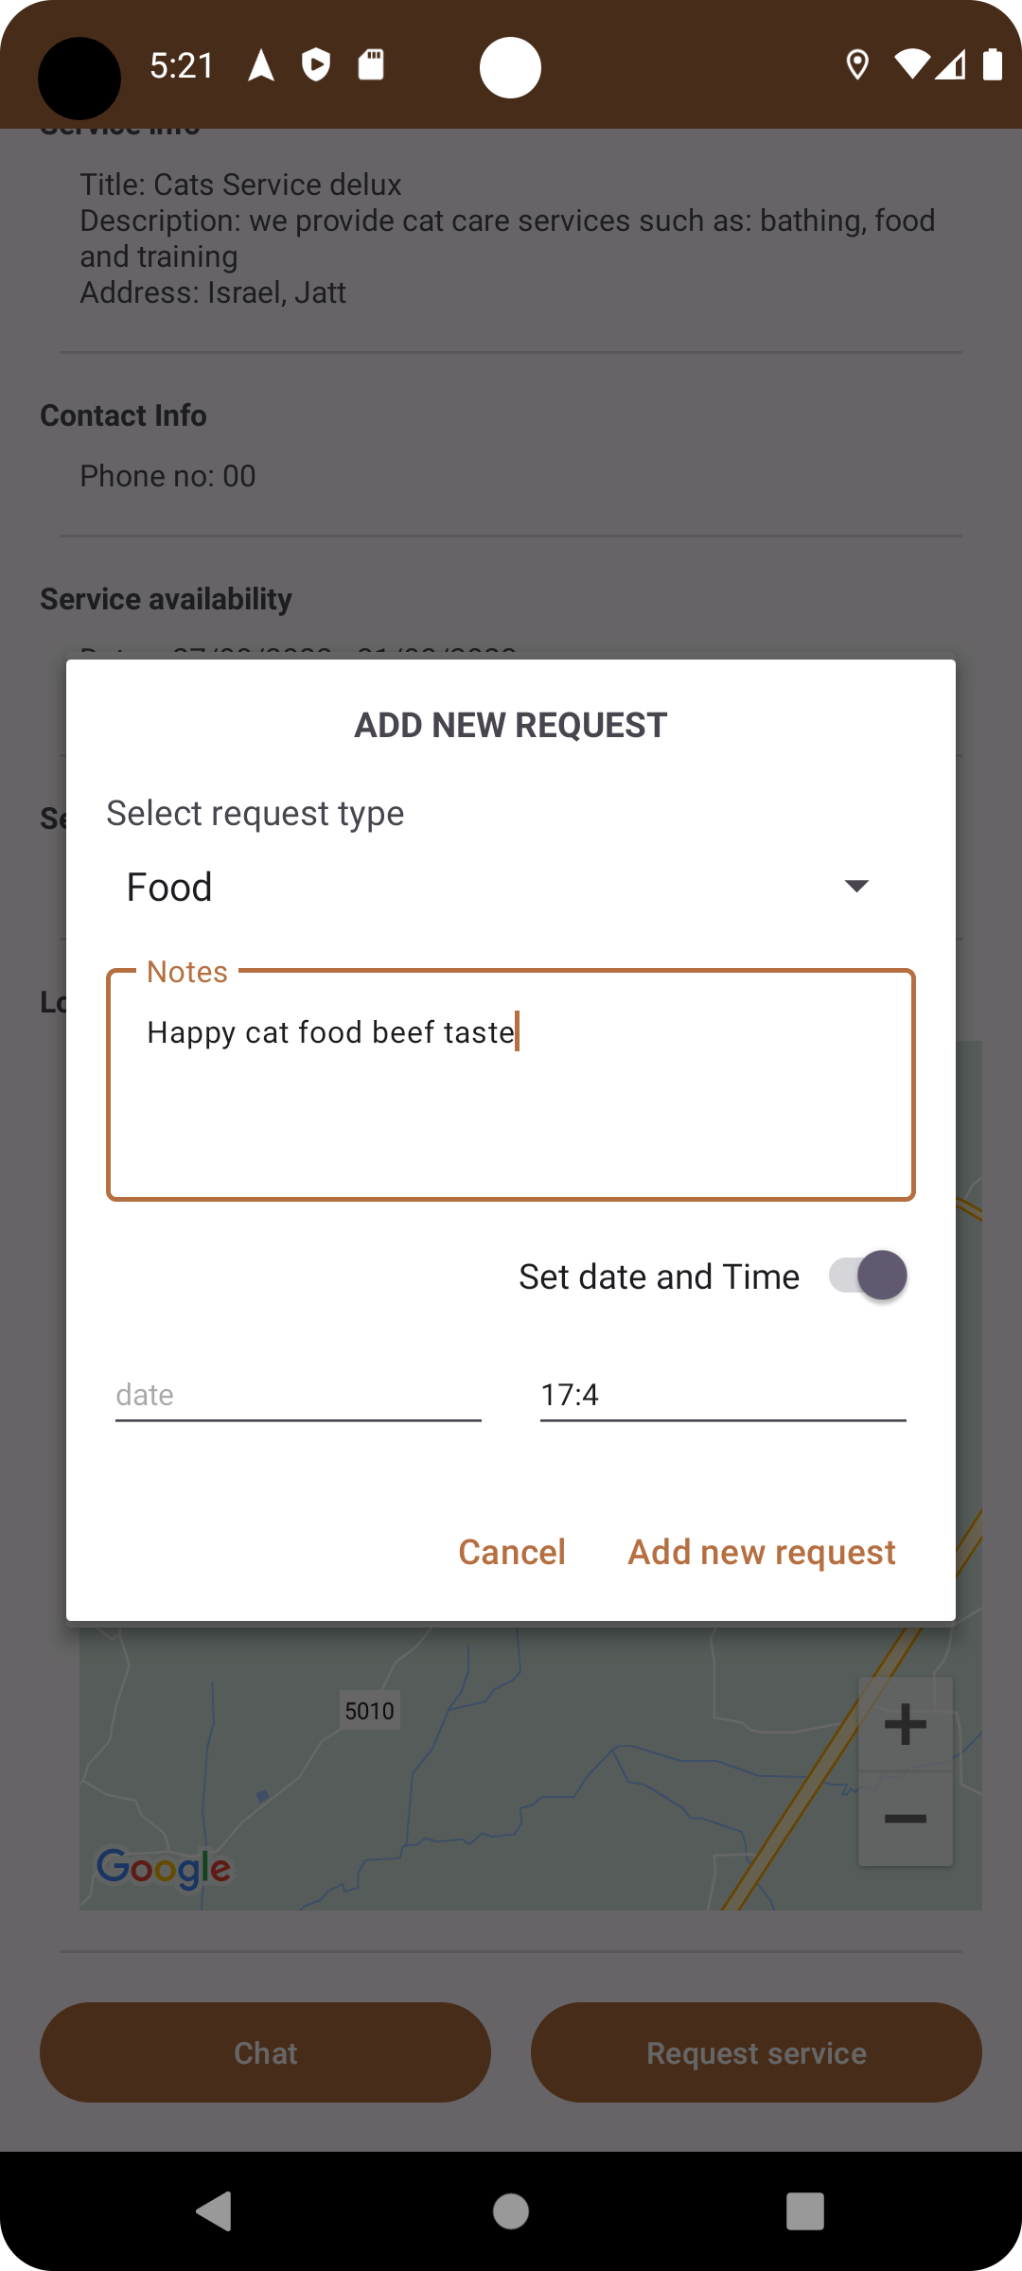
Requesting service flow (2)
Assuming the user clicked on “Request Service” button shown in the previous slide, a pop out to request the service is opened, a span of the service requested is required and there is an option to add details. The user can add new requests as shown on the right side of the slide.

Slide 12
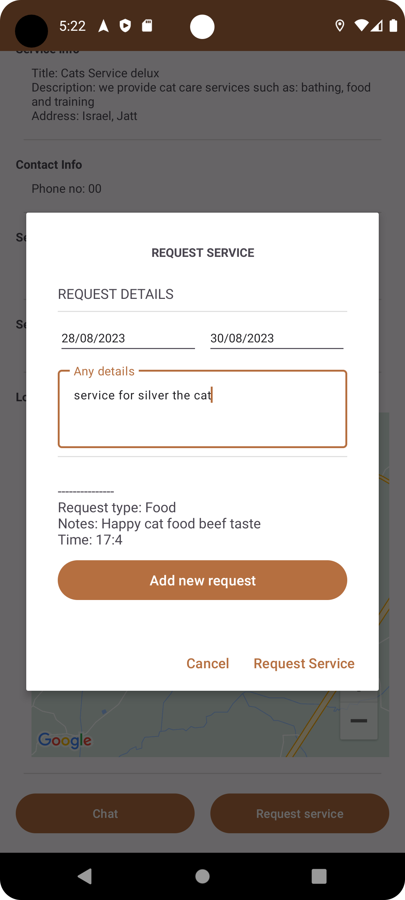
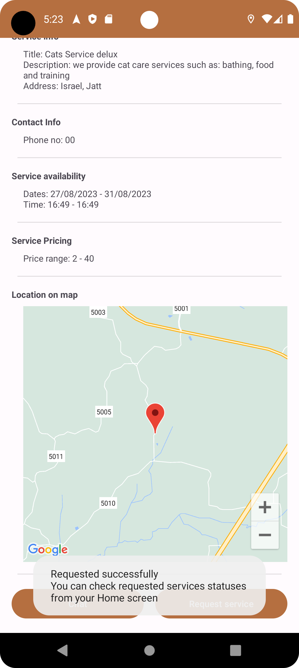
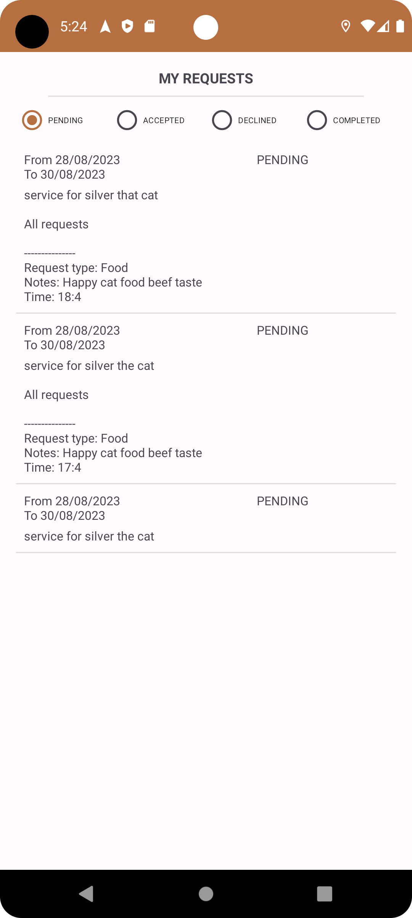
Requesting service flow (3)
After the user adds his requests, he can see them in the pop out before pressing “Request Service” button. When this button is pressed the requested service will be sent to the provider. As a client I can my current and previous requests on “My requests” in the home page, and when clicked the user sees his requests by status.

Slide 13
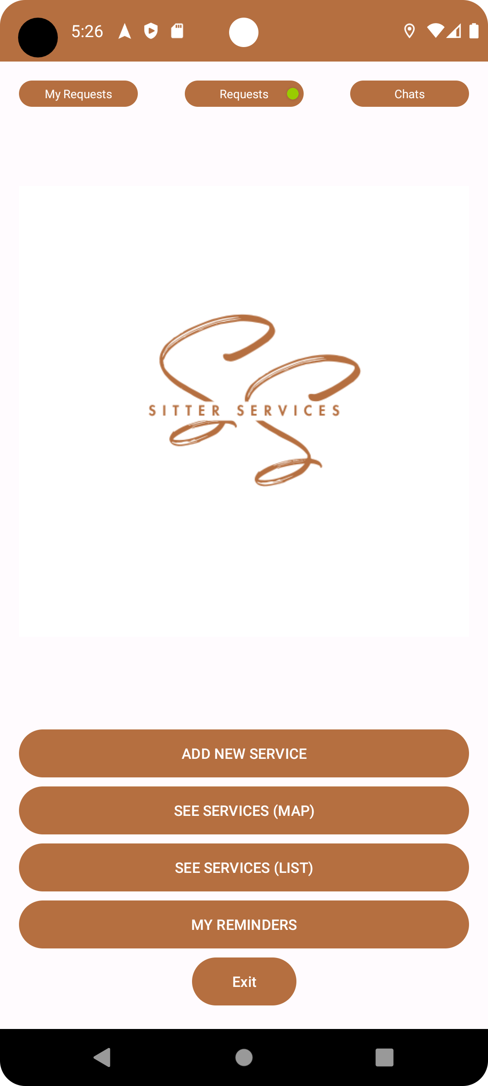
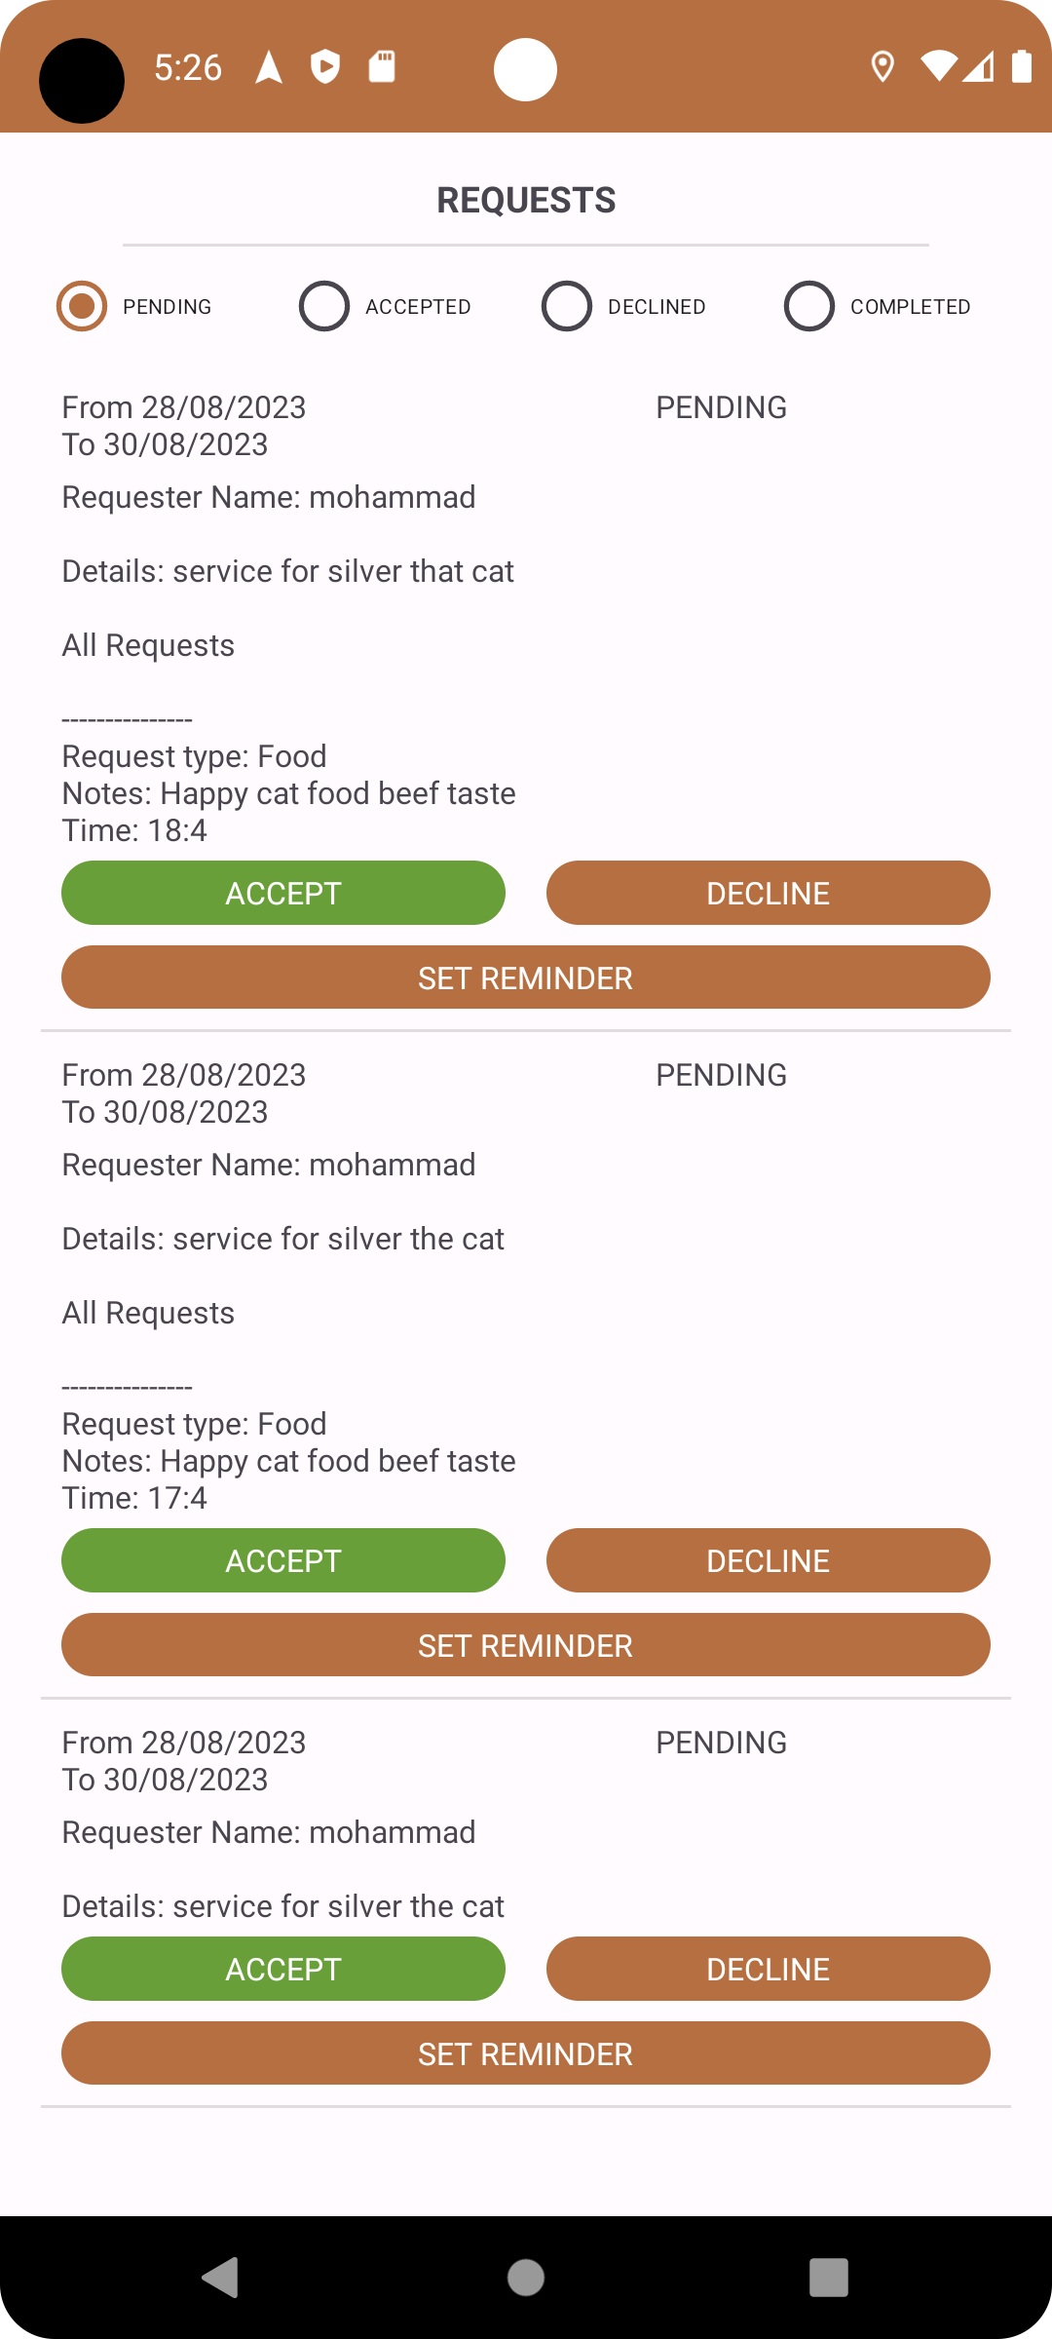
Requesting service flow (4)
On the left side the client screen is shown when “My requests” is clicked form the home screen. After the client sends his requests, in the provider end a notification in the app is shown on “Requests” button indicating a new service request. If clicked a history of services is shown including an option to accept/decline the service.

Slide 14
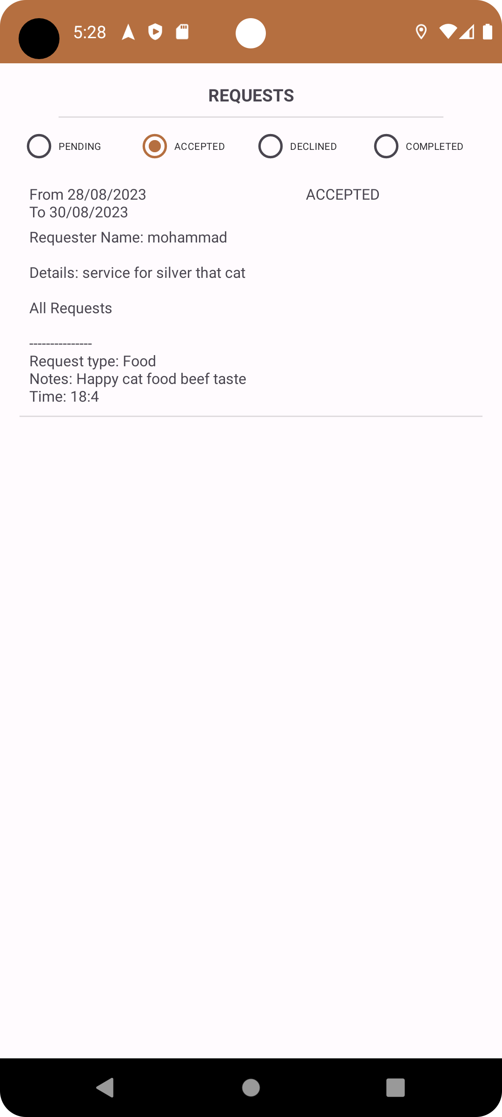
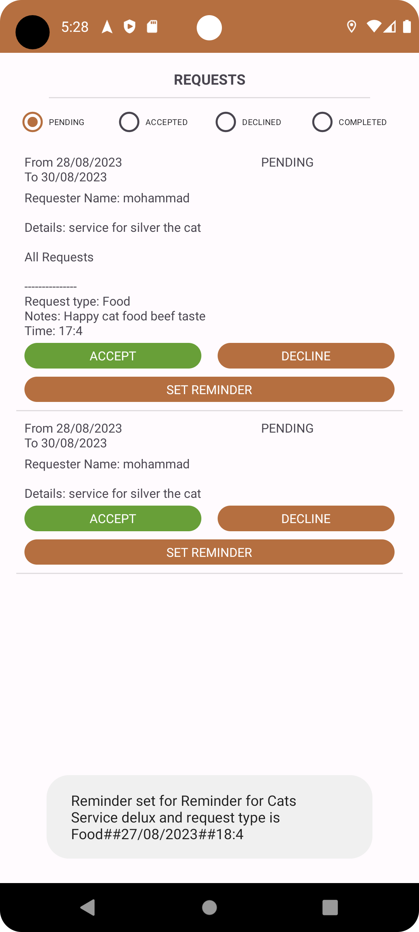
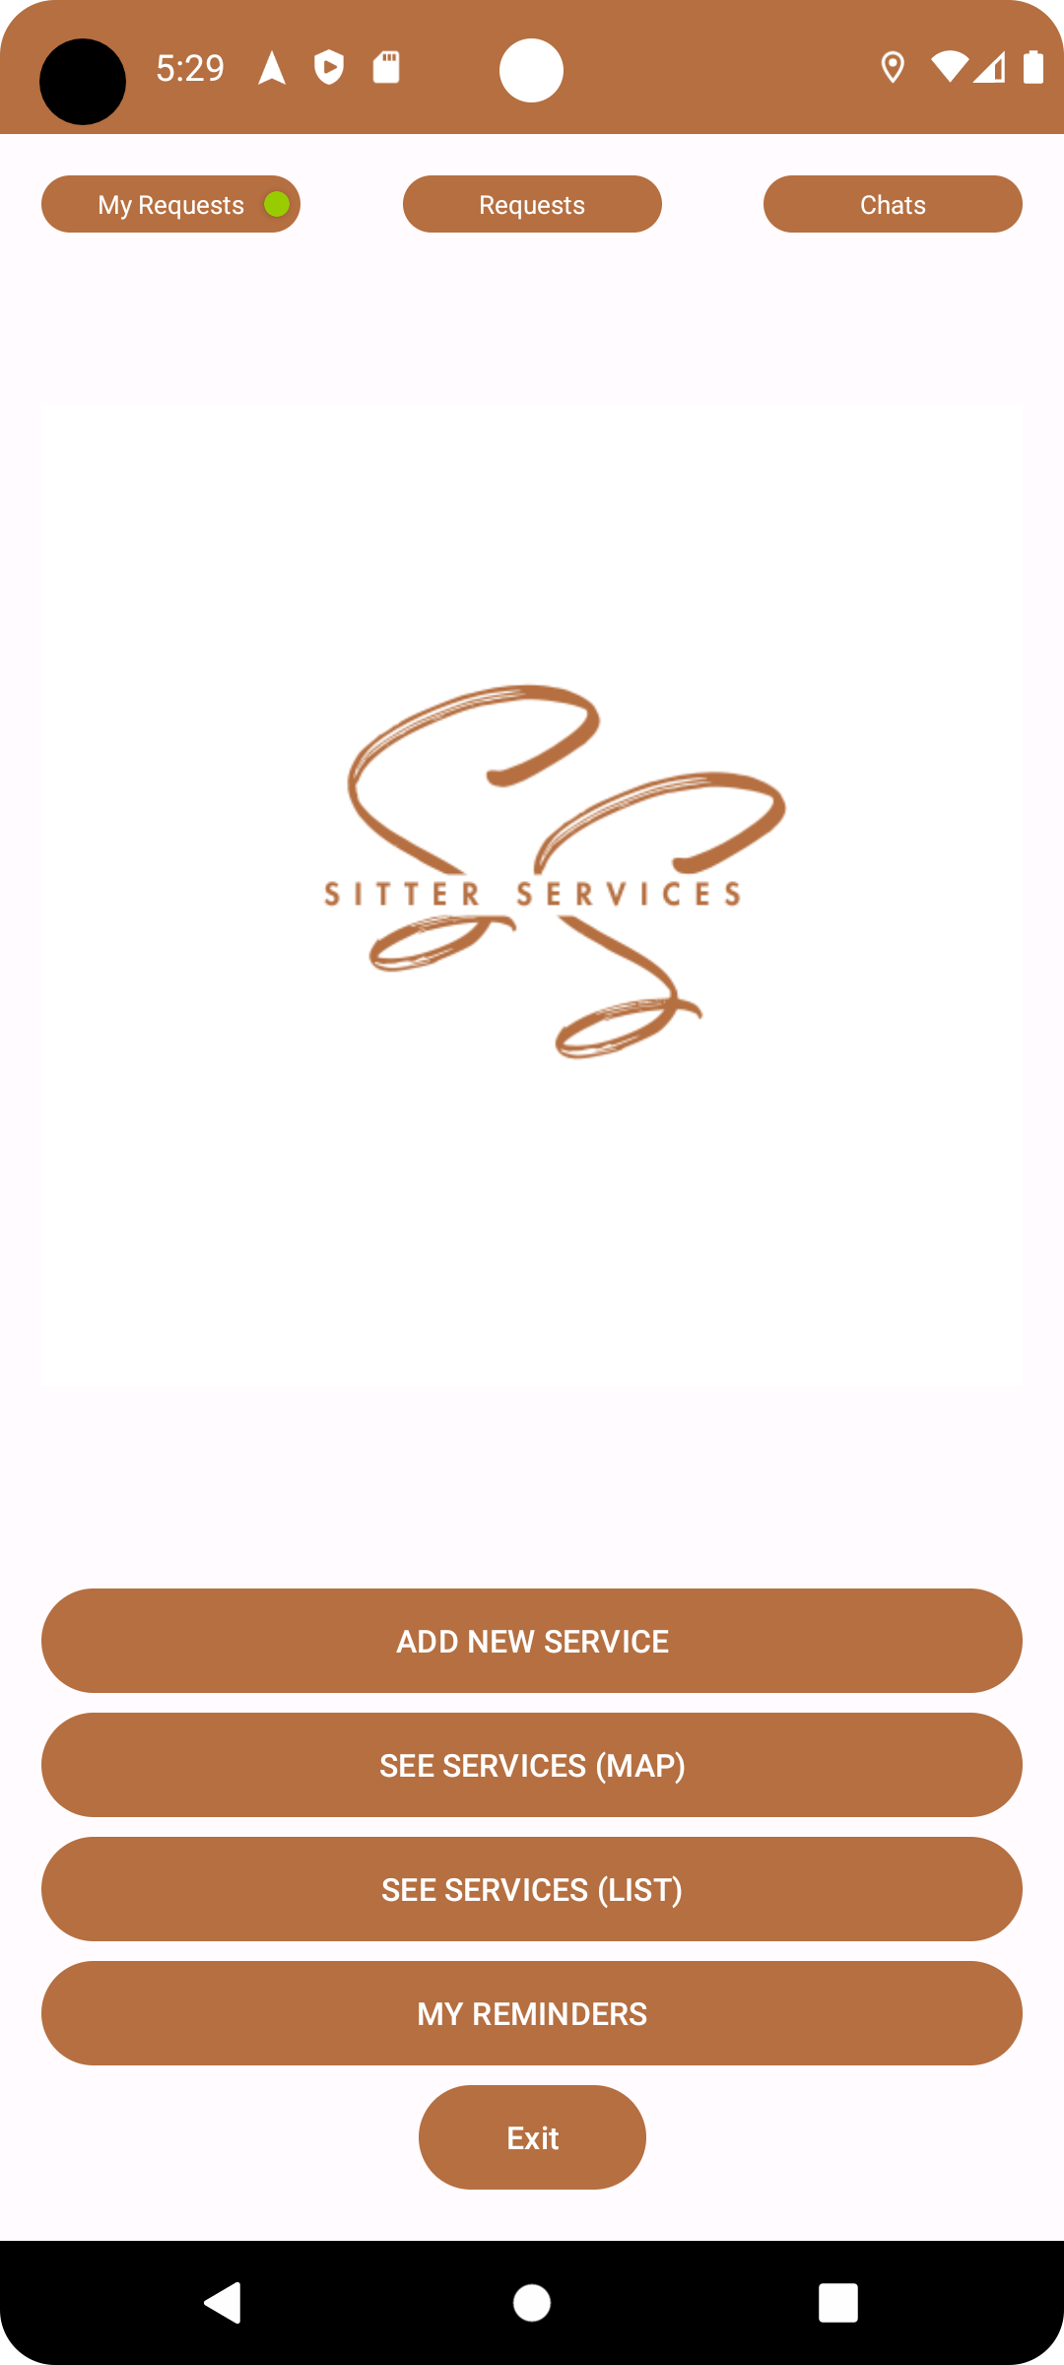
Requesting service flow (5)
Assuming the provider clicked on Accept, the requested service will be moved to “Accepted” status. The provider has the option to set reminder for every request in the associated service. After the provider accepts/declines the service in the client end a notification is shown on “My Request” button.

Slide 15
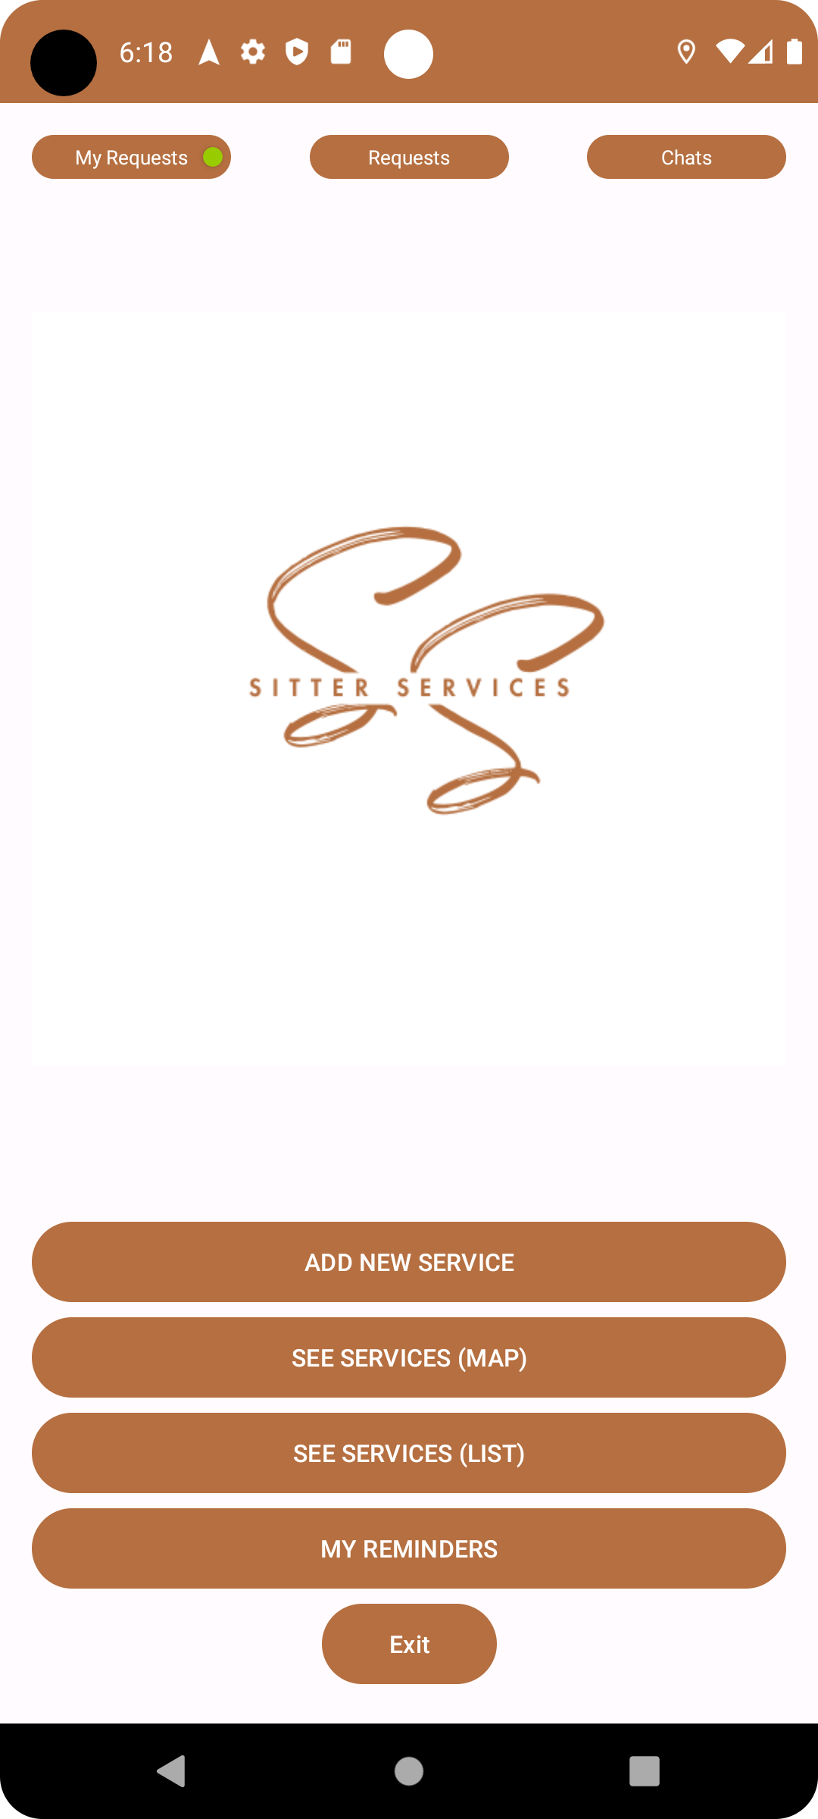
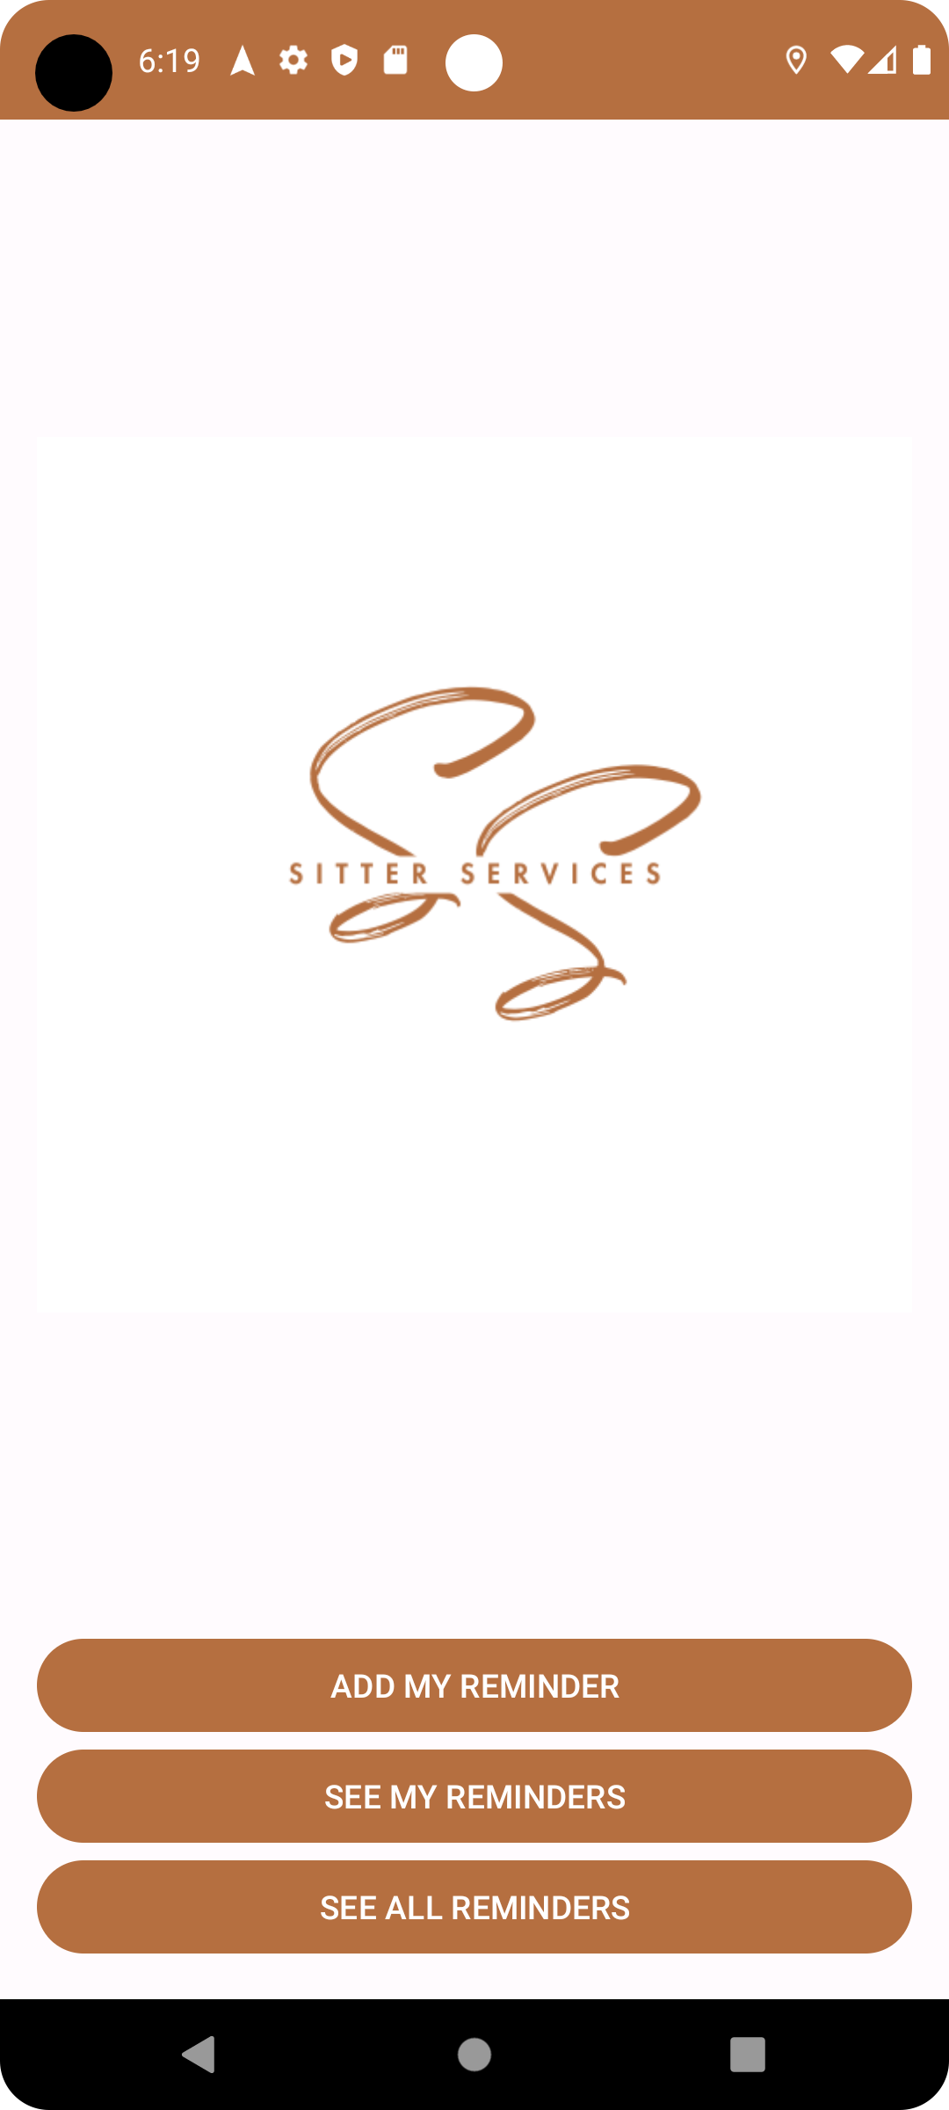
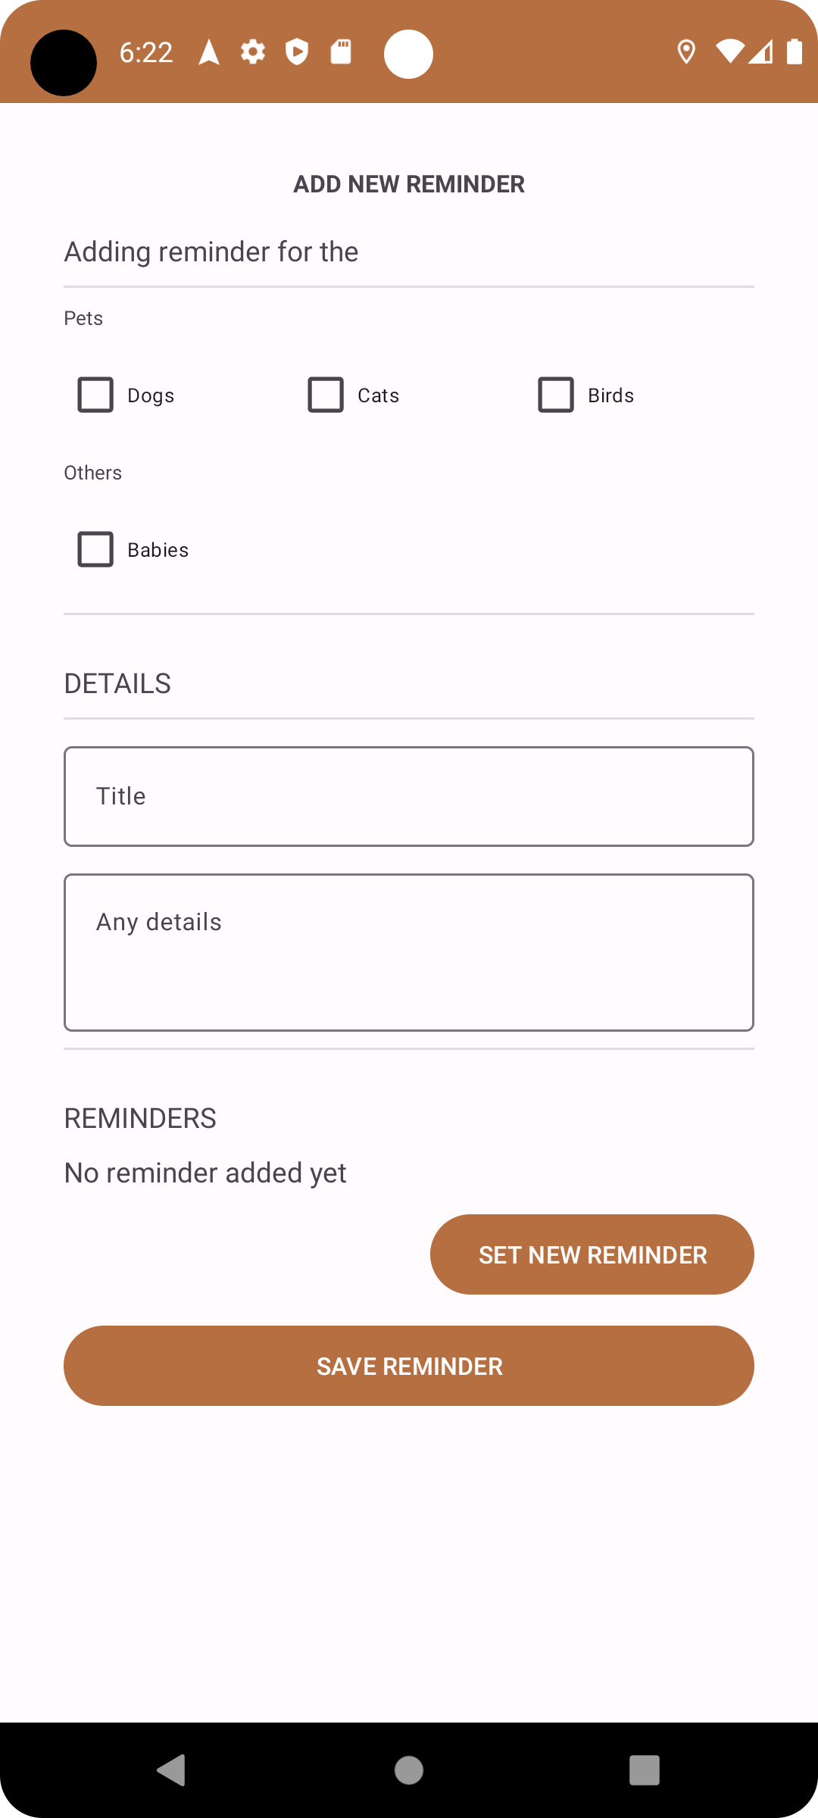
My Reminders feature
Users has the option to set Reminders by pressing on “My Reminders” button on home screen.
“See all my Reminders” is related to providers where they can see all of the reminders from their accepted services.
“Add my reminder” is used by nay user to set reminders by date/time.
“See my reminders” when clicked a list of all reminder will be shown.

Slide 16
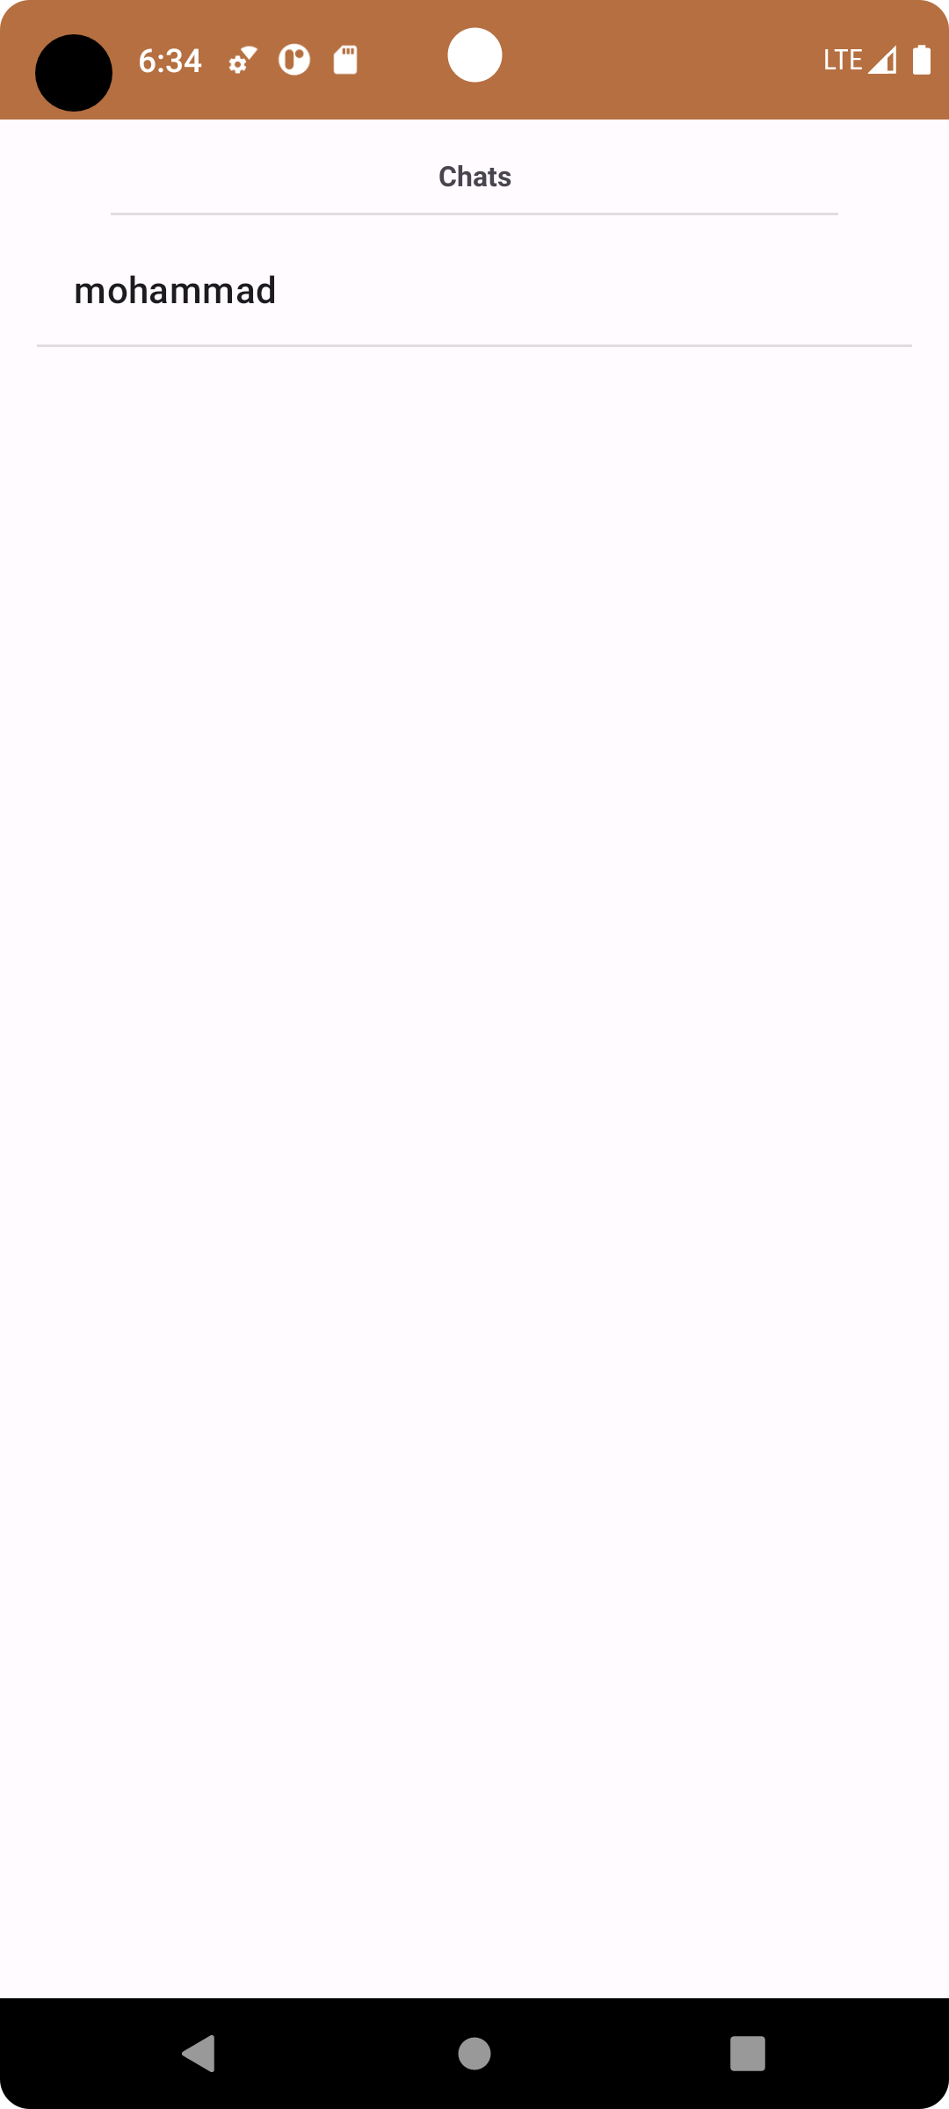
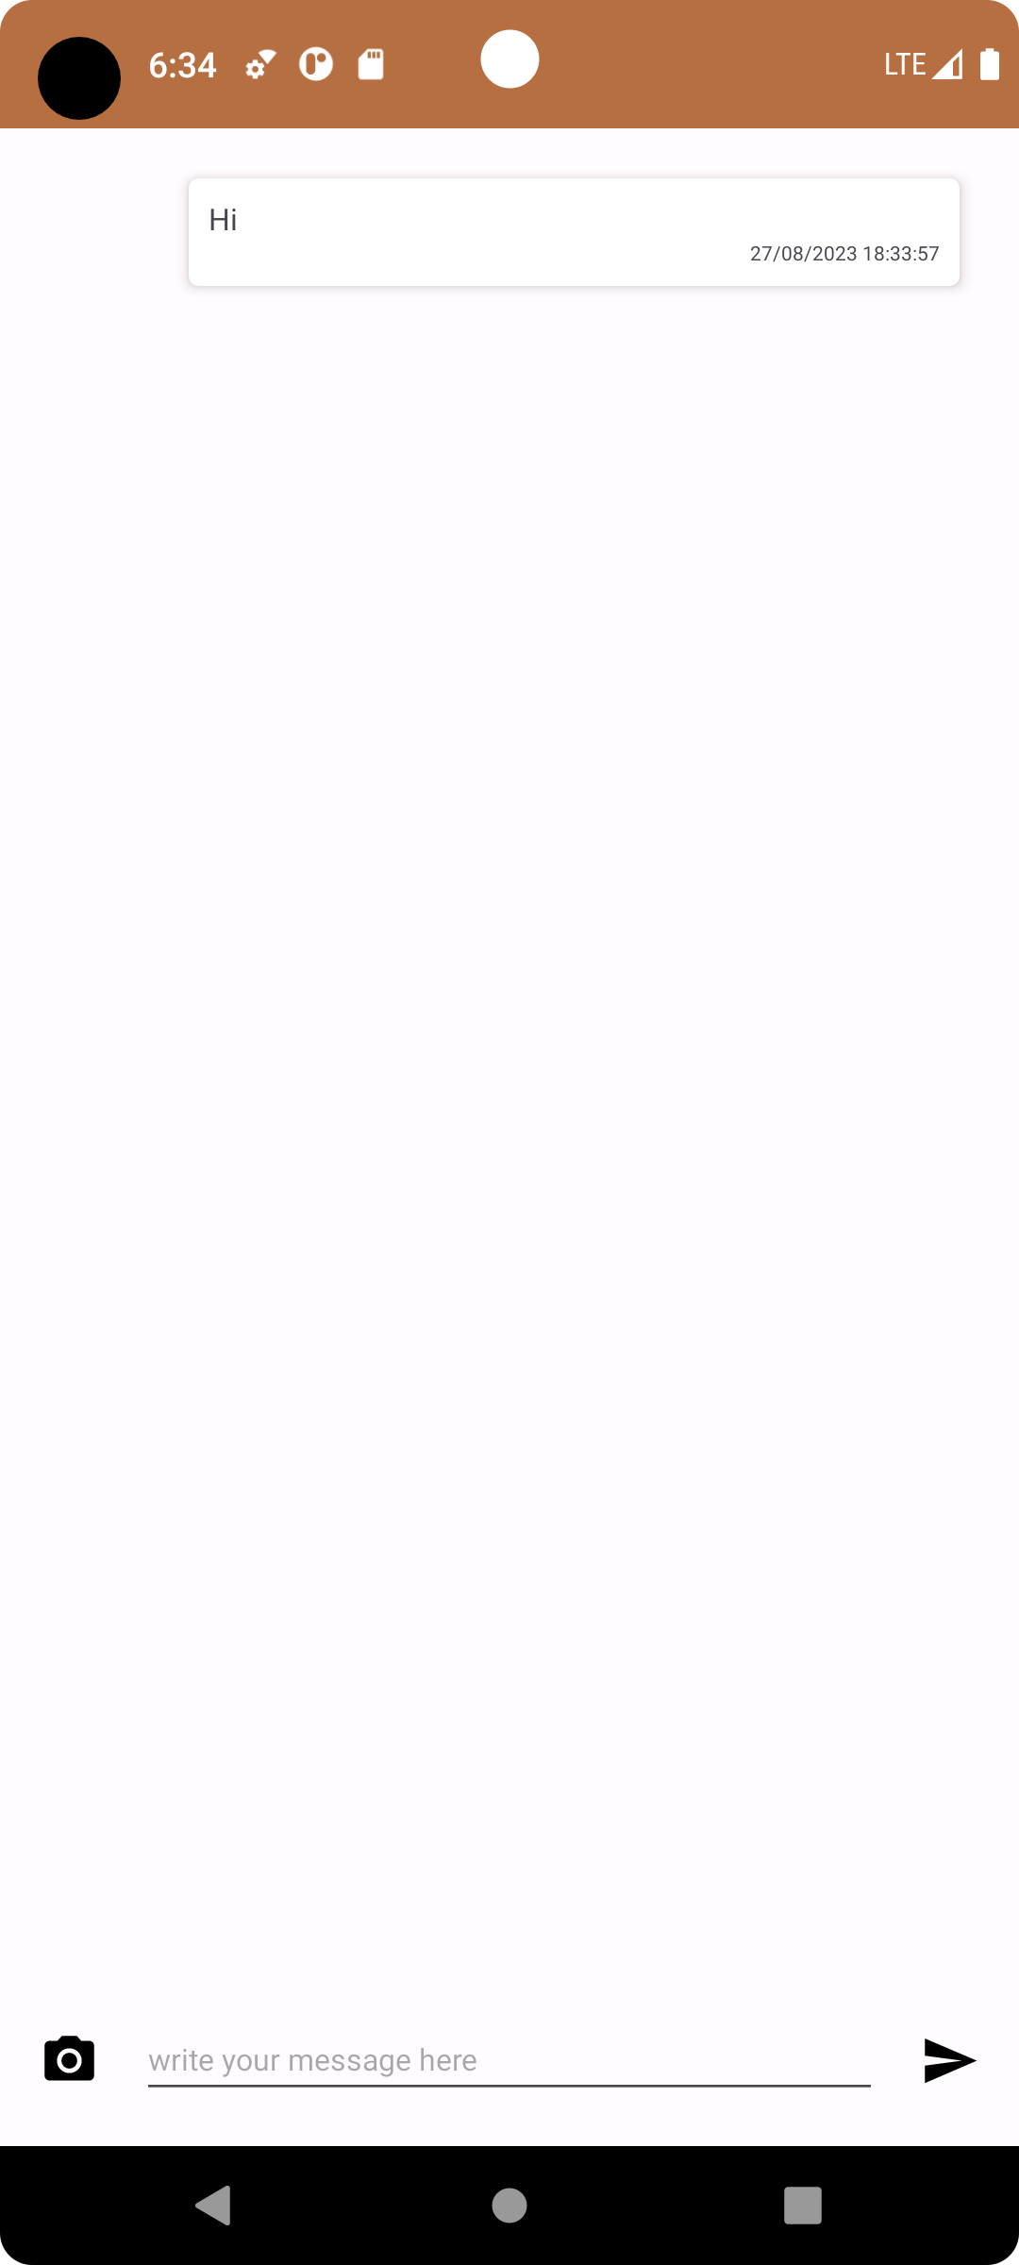

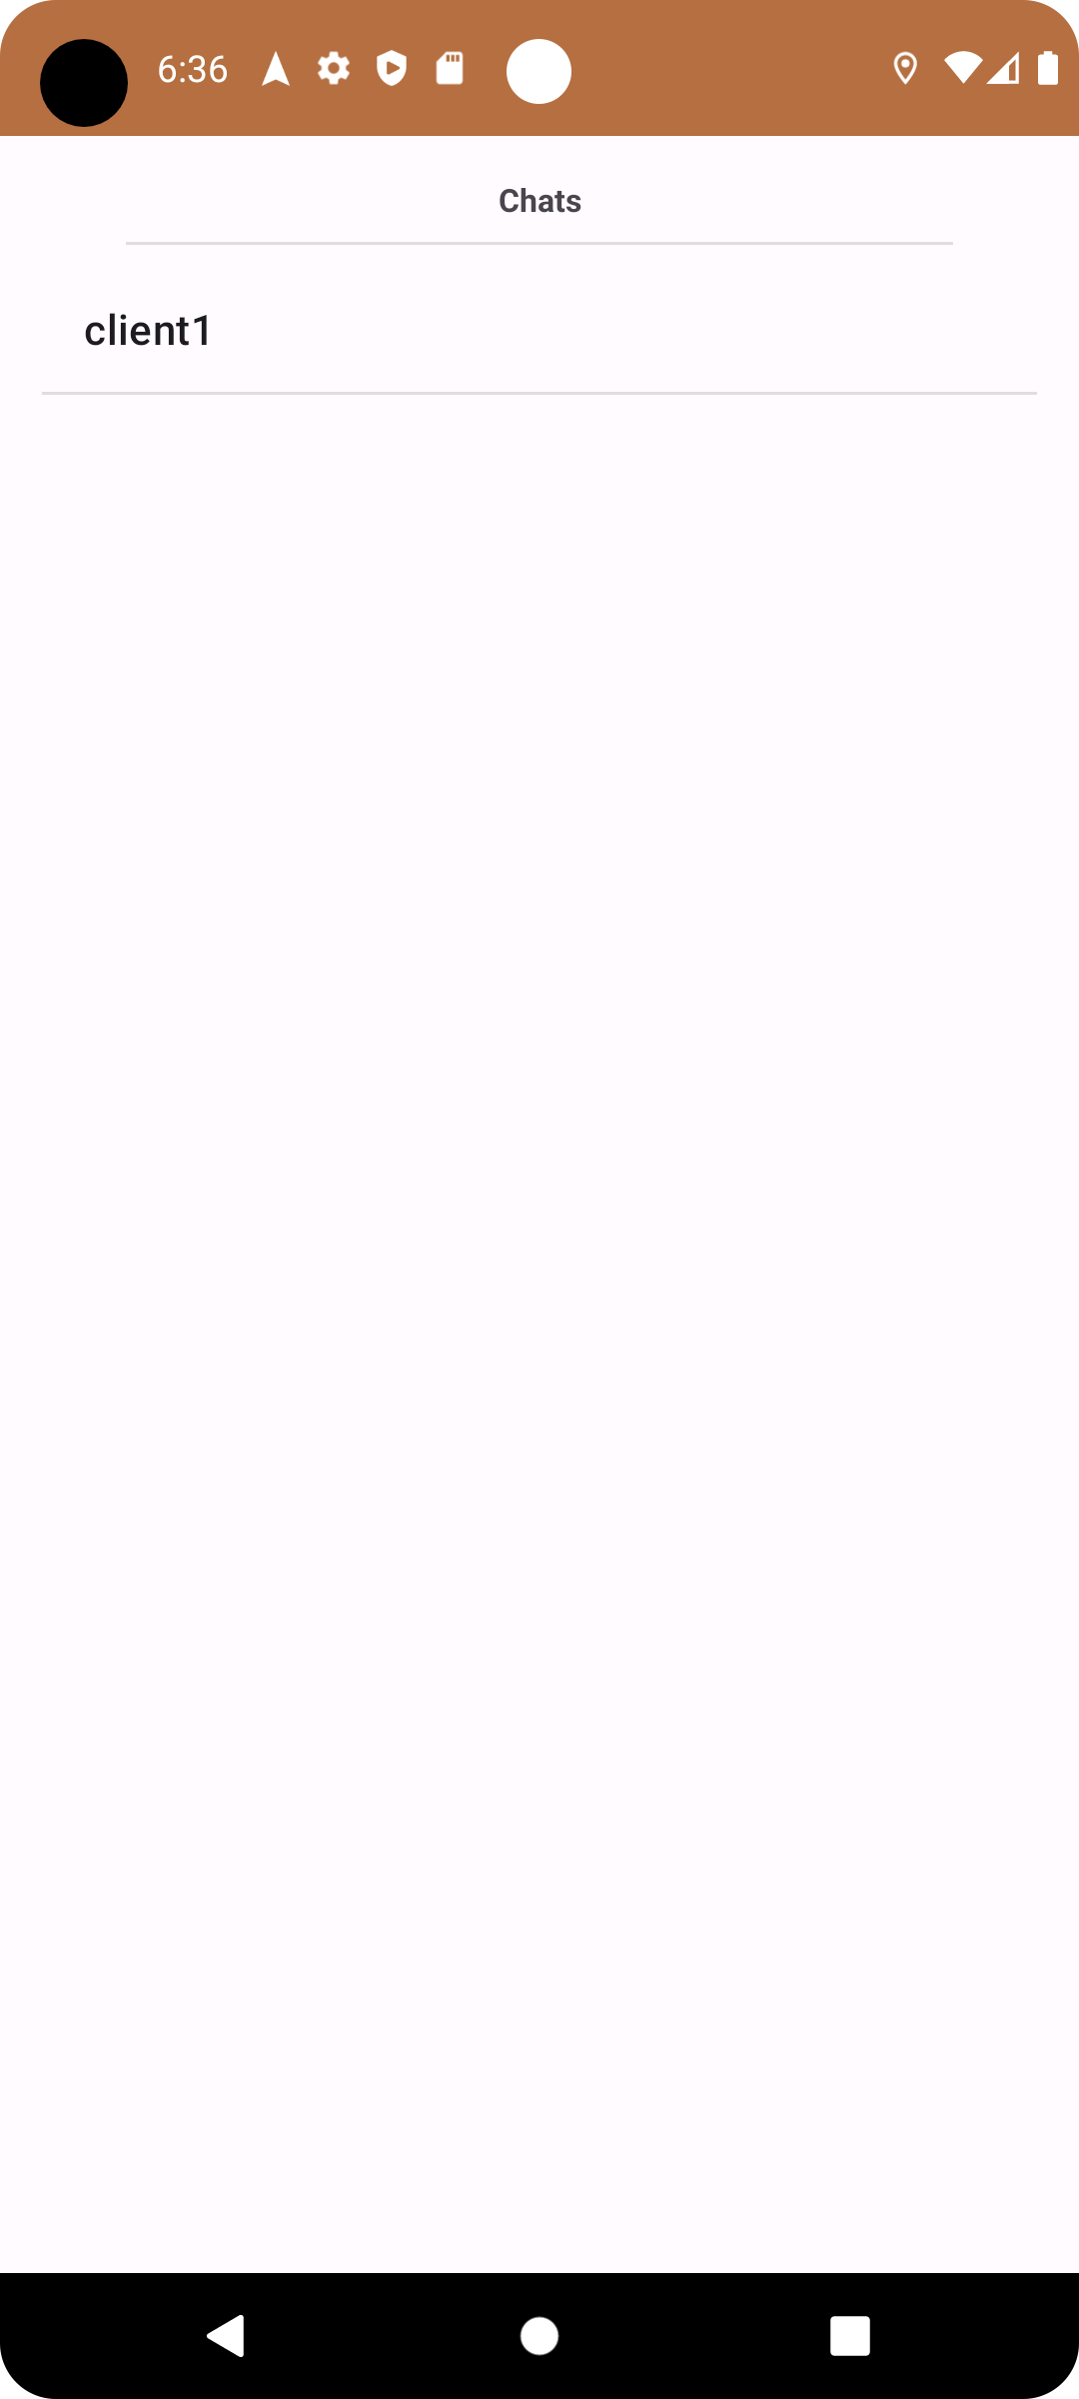
Chat Feature (1)
As shown previously, users can chat with each other in real time. Left side is from the client1 sending a message to user mohammad. On the right side a notification appears on user mohammad side and a new chat (client1) appears.

Slide 17
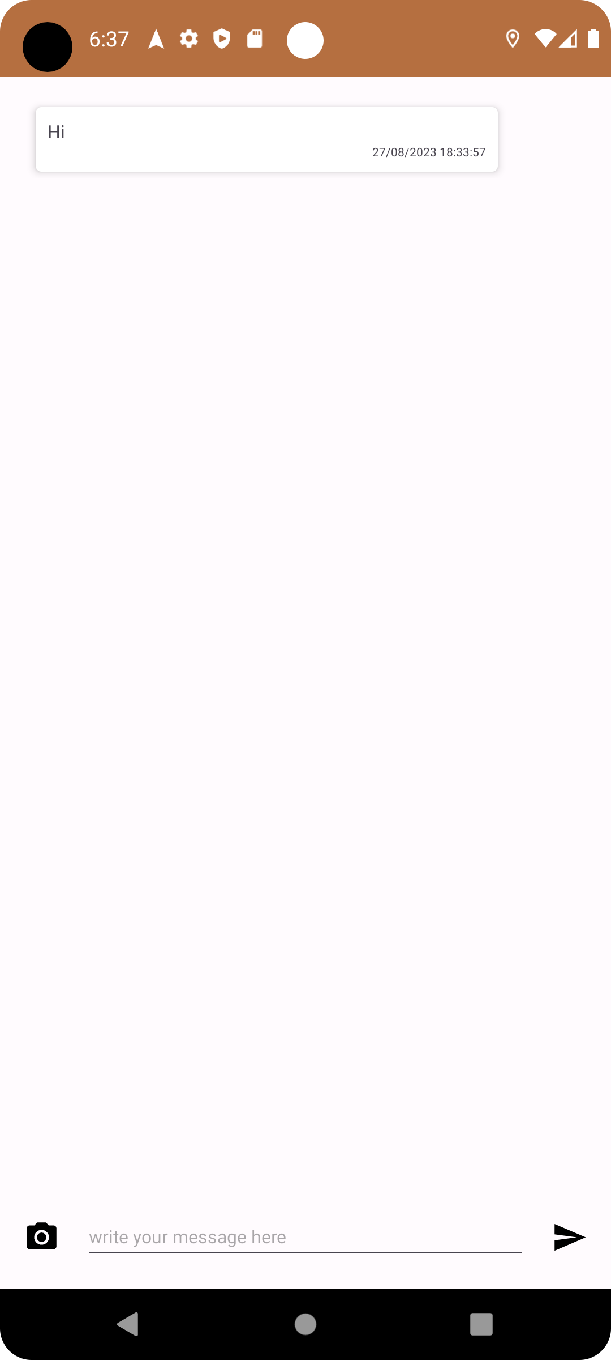
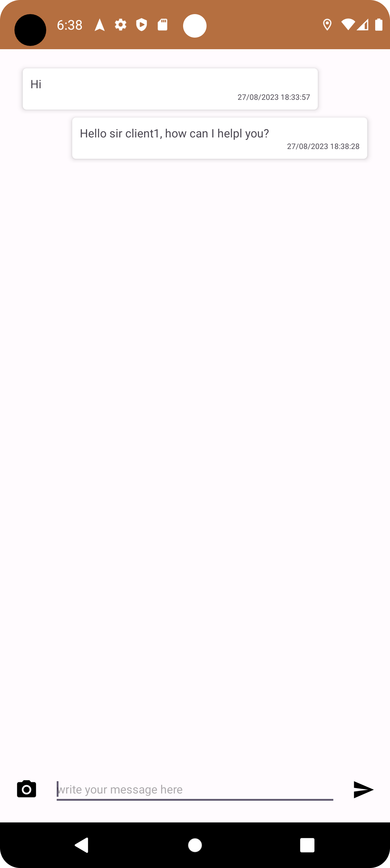
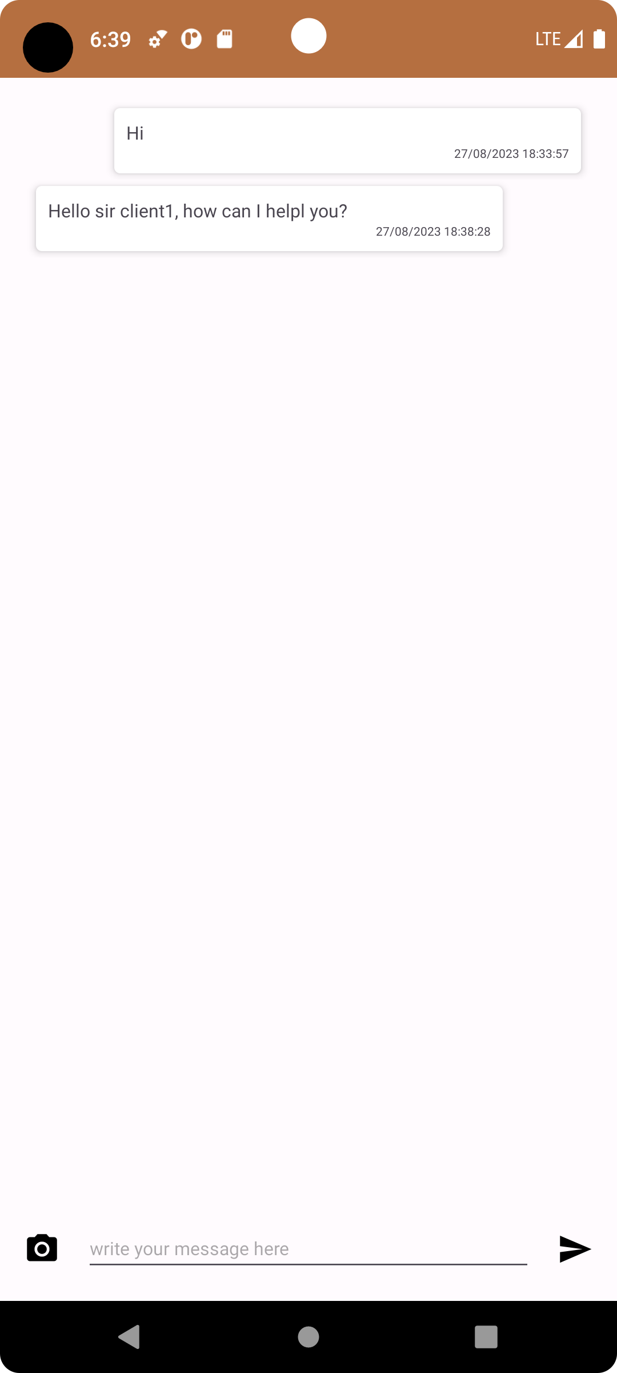
Chat Feature (2)
User mohammad end
User client1 end

